Slide 1
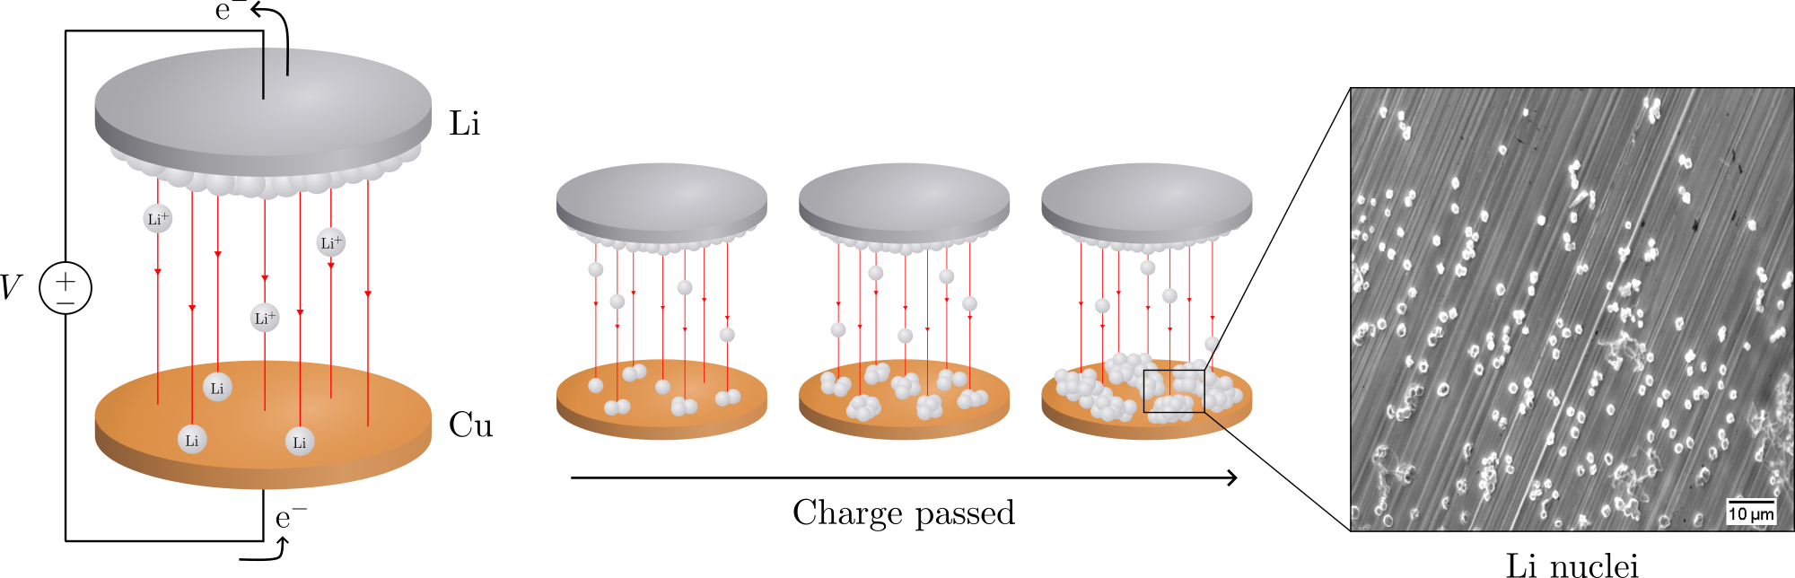
Electrochemical deposition of lithium on copper
Gottfrid Olsson
2024‒05–29
Notes:
Hello and welcome!
My name is Gottfrid Olsson and this master’s thesis is about electrochemical deposition of lithium on copper.

Slide 2
PLAN: 25 minute presentation

Slide 3
Batteries!
Notes:
How many here have either a smartphone, a laptop, or an electric car? [raise my hand]
Cool, then you are using batteries every day, and you likely own at least one lithium-ion battery – a very common battery type …

Slide 4
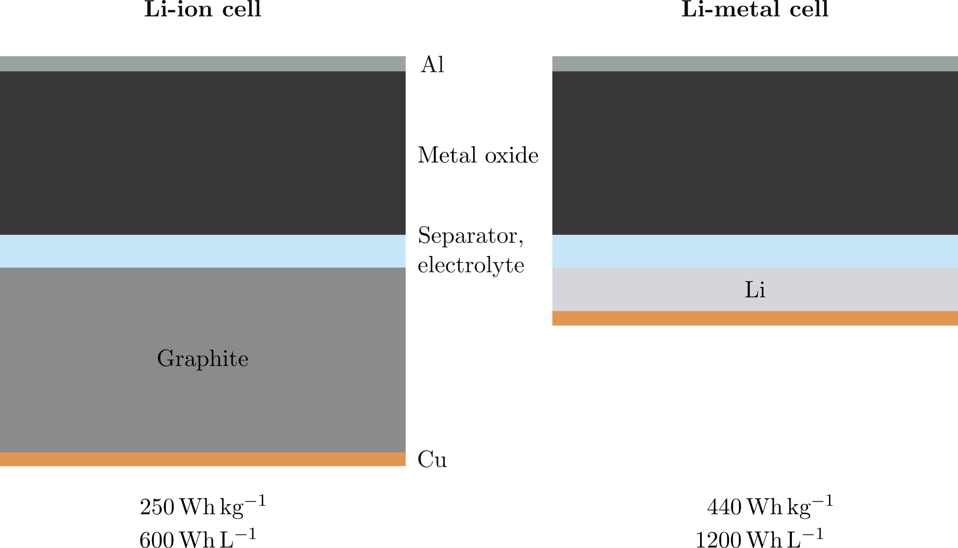
Batteries!
Notes:
These are the parts. [short pause]
If we replace the graphite with Li …

Slide 5
Batteries!
Notes:
We get a lithium-metal battery.
This change from graphite to lithium can …

Slide 6
Batteries!
Notes:
Drastically increase the energy per weight and doubles the energy per volume of the cell.
This would not only make your laptop easier to carry, but would benefit for example electrical vehicles where the size and weight of today’s batteries are an obstacle.
In the Li-ion cell, Li moves between the metal oxide and into the graphite.
Having removed the graphite, the Li must instead deposit on the surface.
This unfortunately leads to some problems.
At the pack level:
* Li-ion cell: 150 Wh/kg, 250 Wh/L
Li-metal cell: 250 Wh/kg, 750 Wh/L
(http://large.stanford.edu/courses/2020/ph240/kim1/)

Slide 7
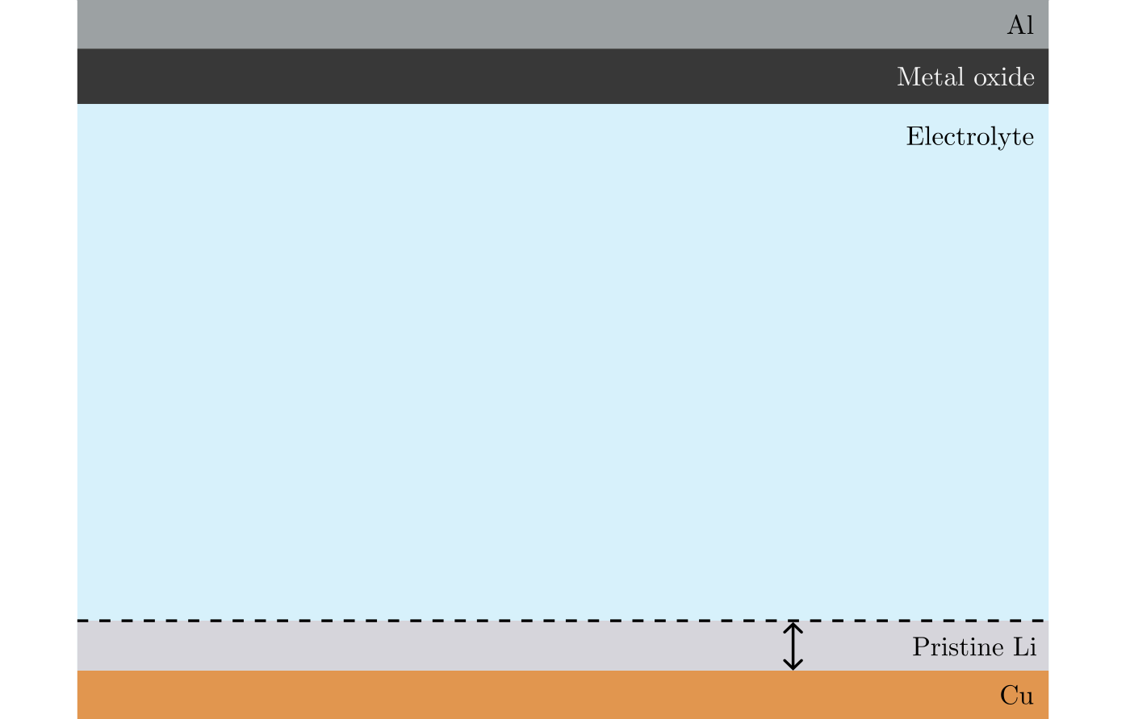
Non-uniform deposition problems
Notes:
Say we have a new cell which we charge and discharge many times: this means Li moves up during discharging [point], and back down during charging [point].

Slide 8
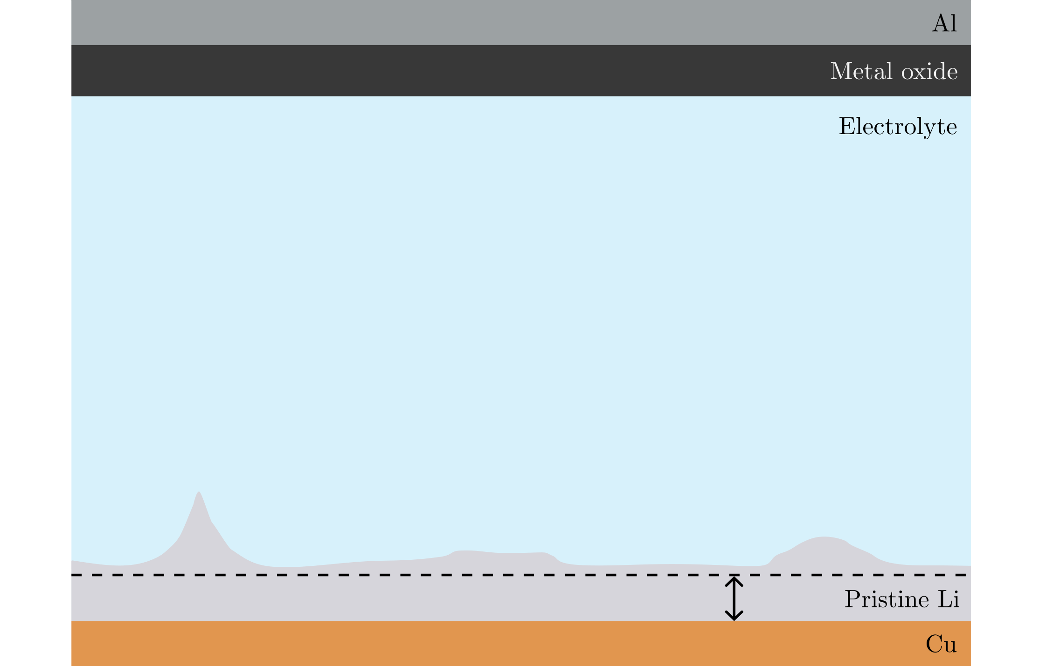
Non-uniform deposition problems
Notes:
Li can over time get deposited on the surface more in some places than others…

Slide 9
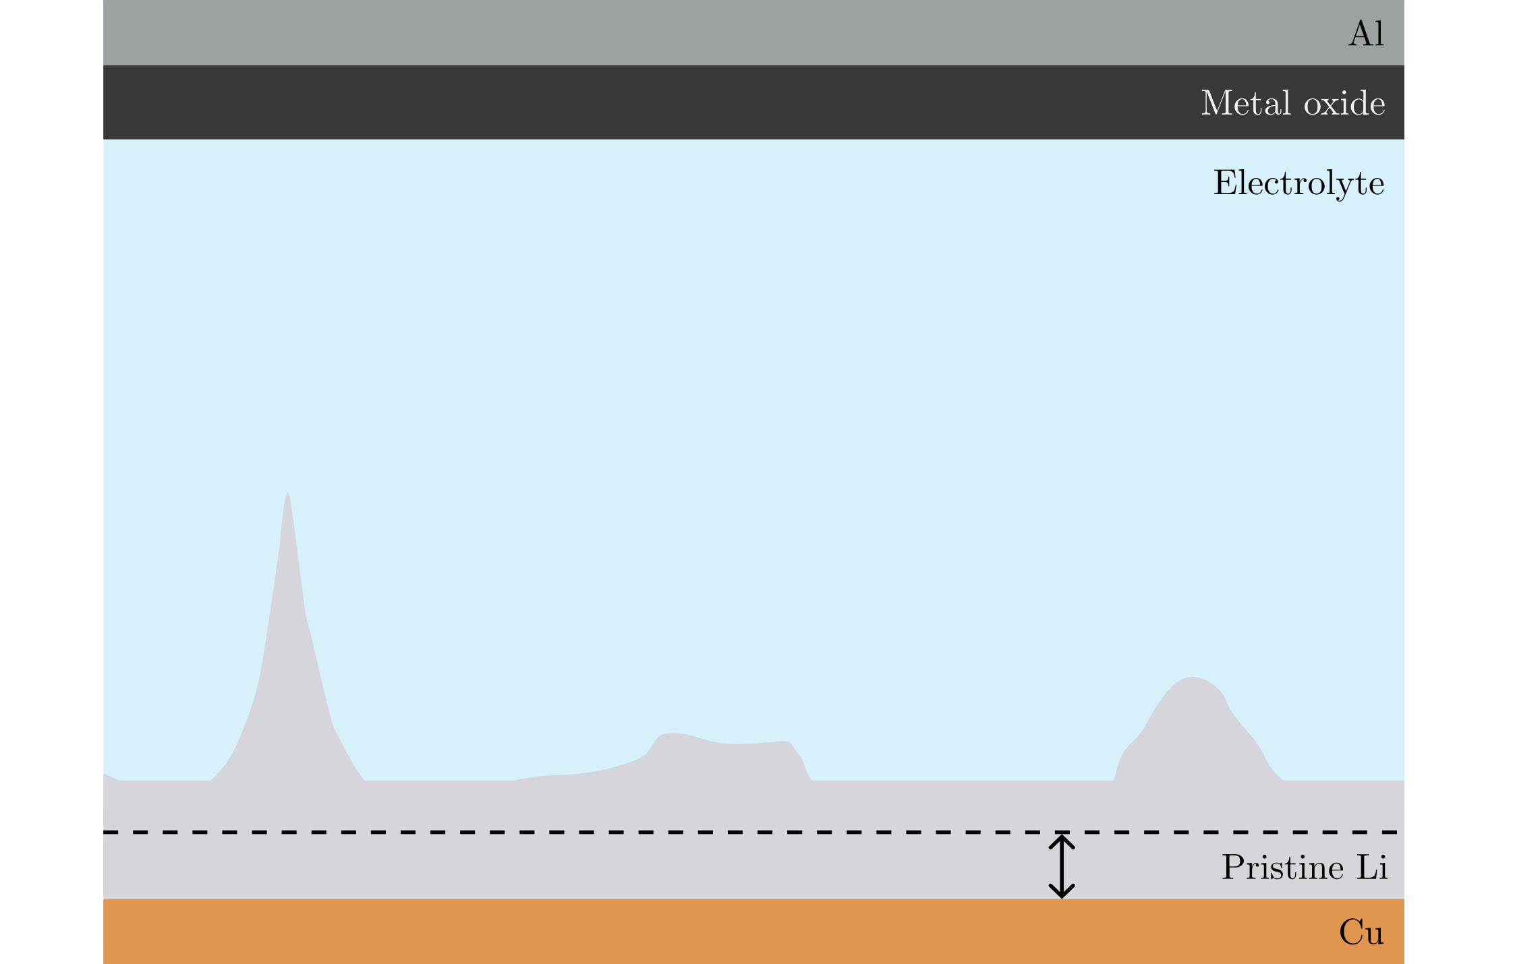
Non-uniform deposition problems
Notes:
Those places can then grow further…

Slide 10
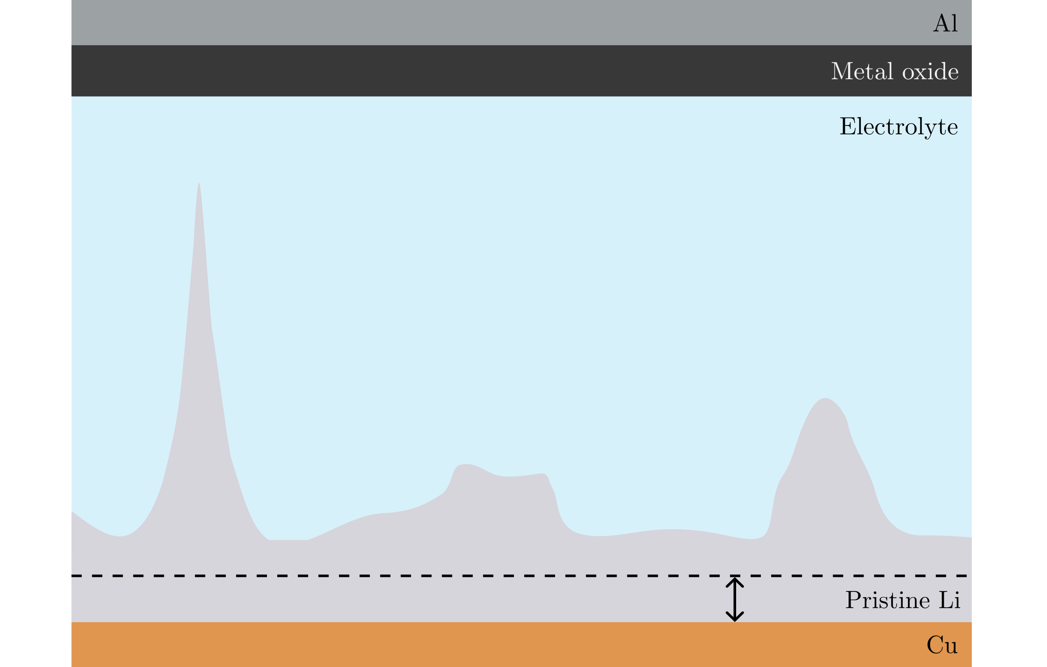
Non-uniform deposition problems
Notes:
And even more until, in the worst case…

Slide 11
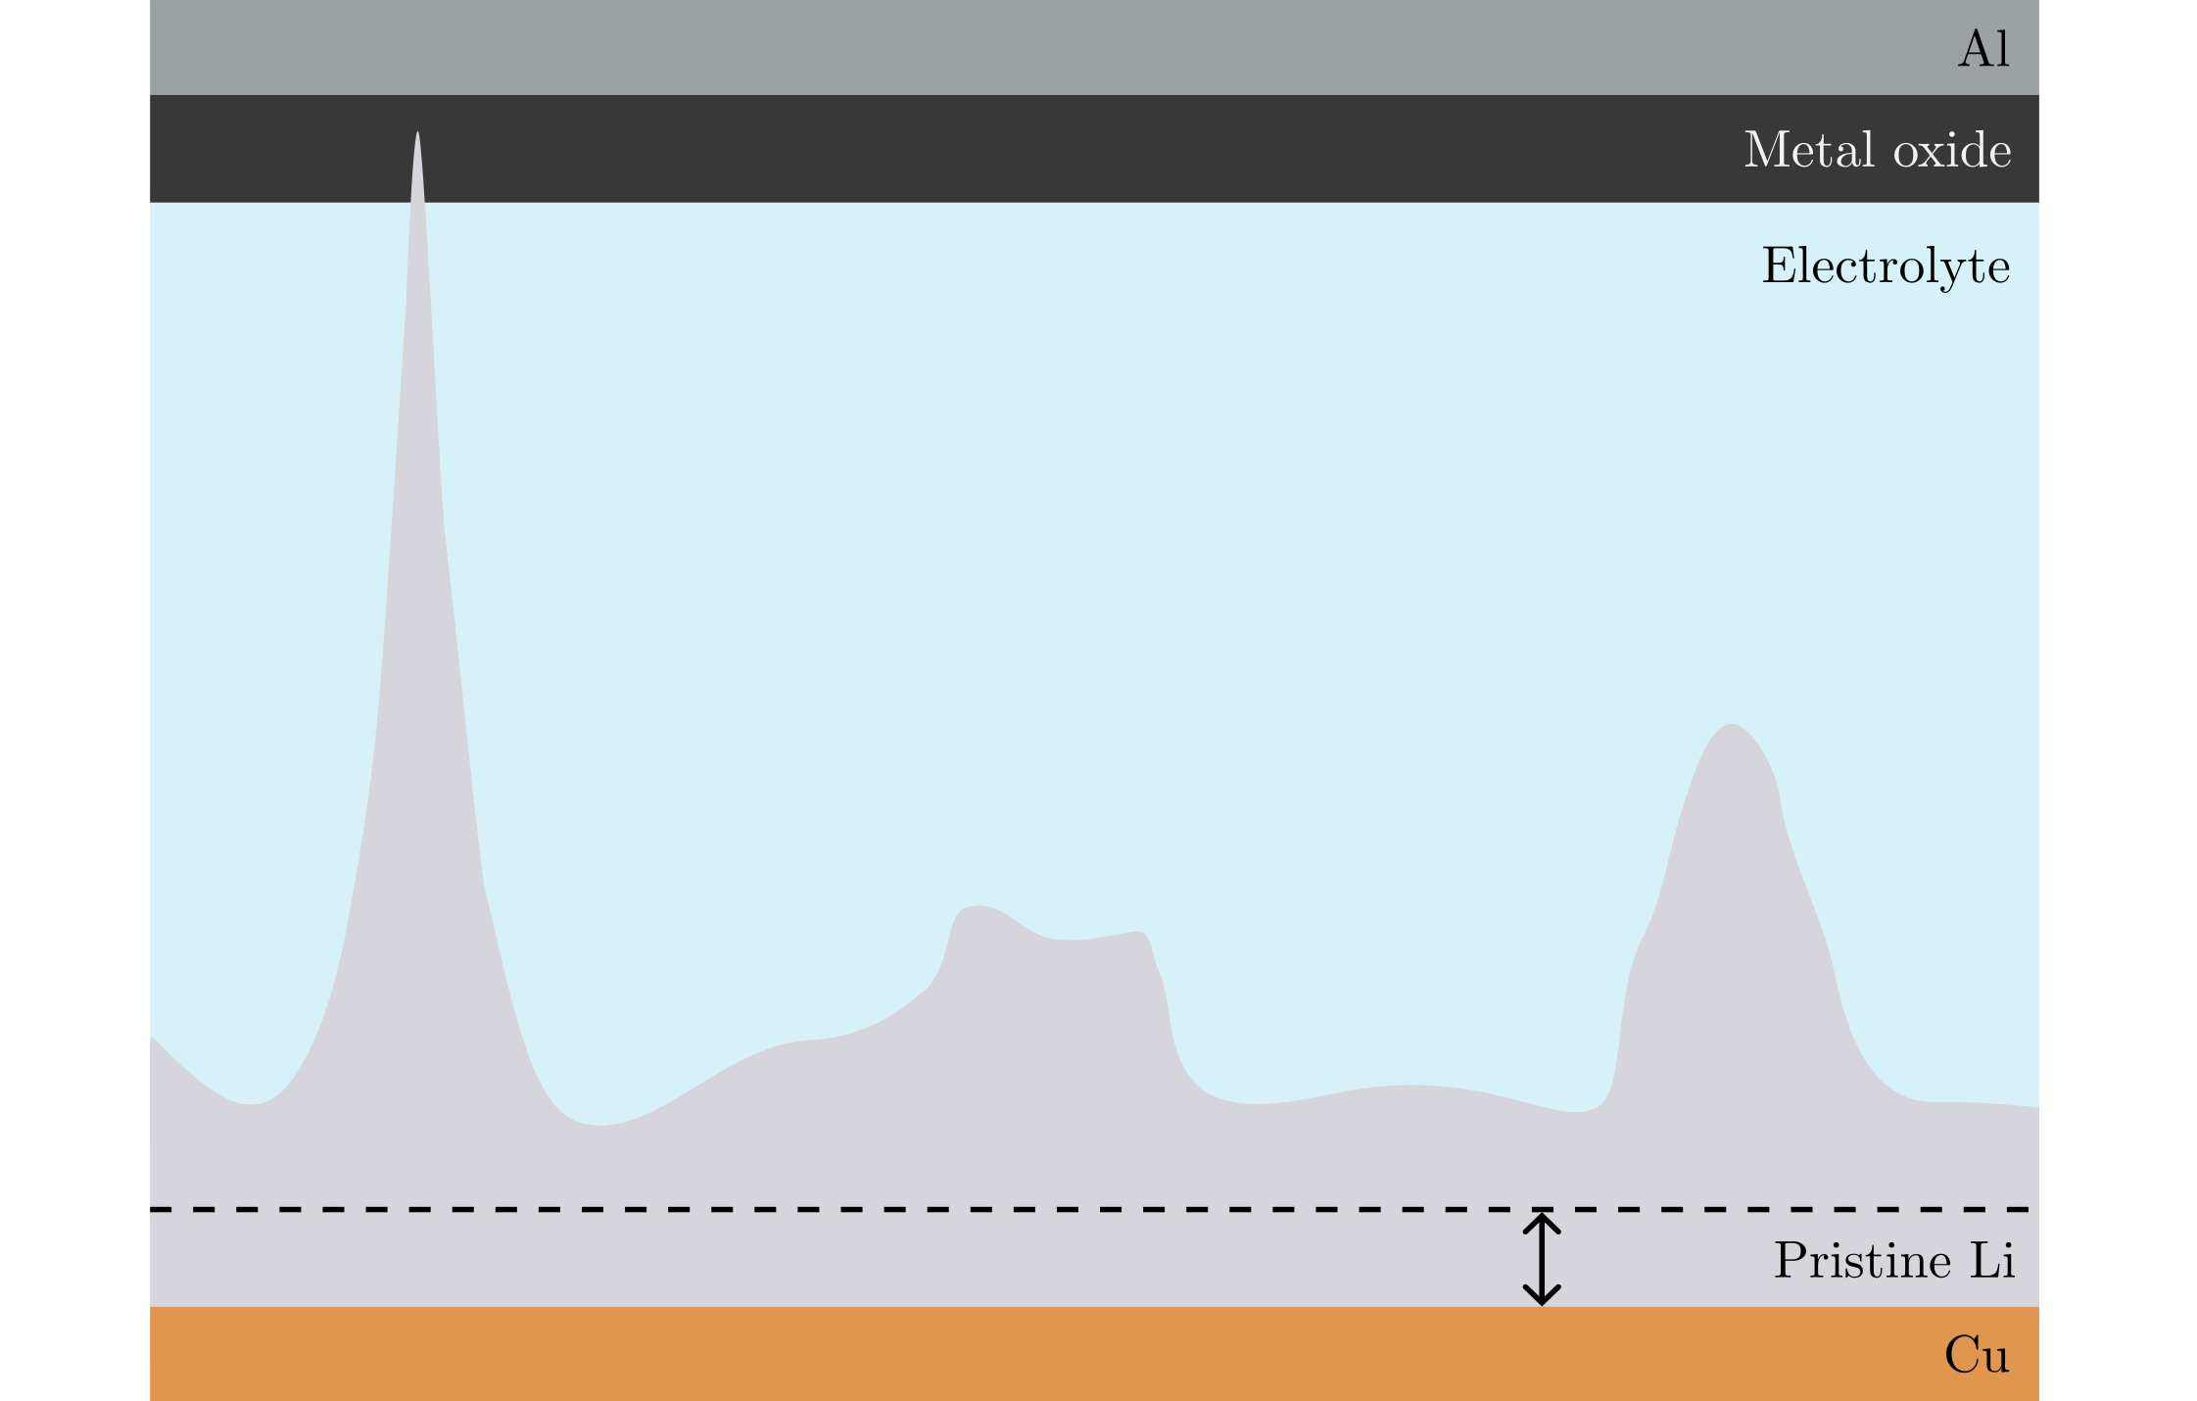
Non-uniform deposition problems
Notes:
It reaches the other side and short circuits the cell. This can lead to an explosion, and is a major safety risk.

Slide 12
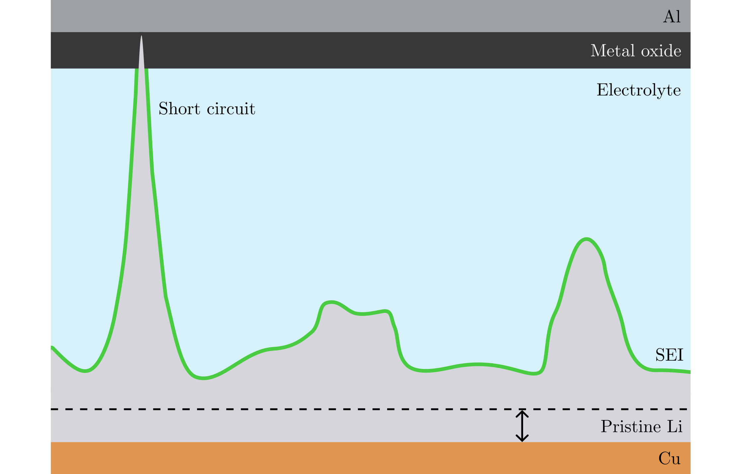
Non-uniform deposition problems
Notes:
Short circuit is one of the problems caused by non-uniform deposition.
Other problems has to do with this this green stuff called the solid electrolyte interphase – SEI.
For low voltage, the electrolyte is chemically broken down and reacts with the Li, forming this SEI layer.
It is generally good because it passivates the surface – preventing other reactions from occurring.
But …

Slide 13
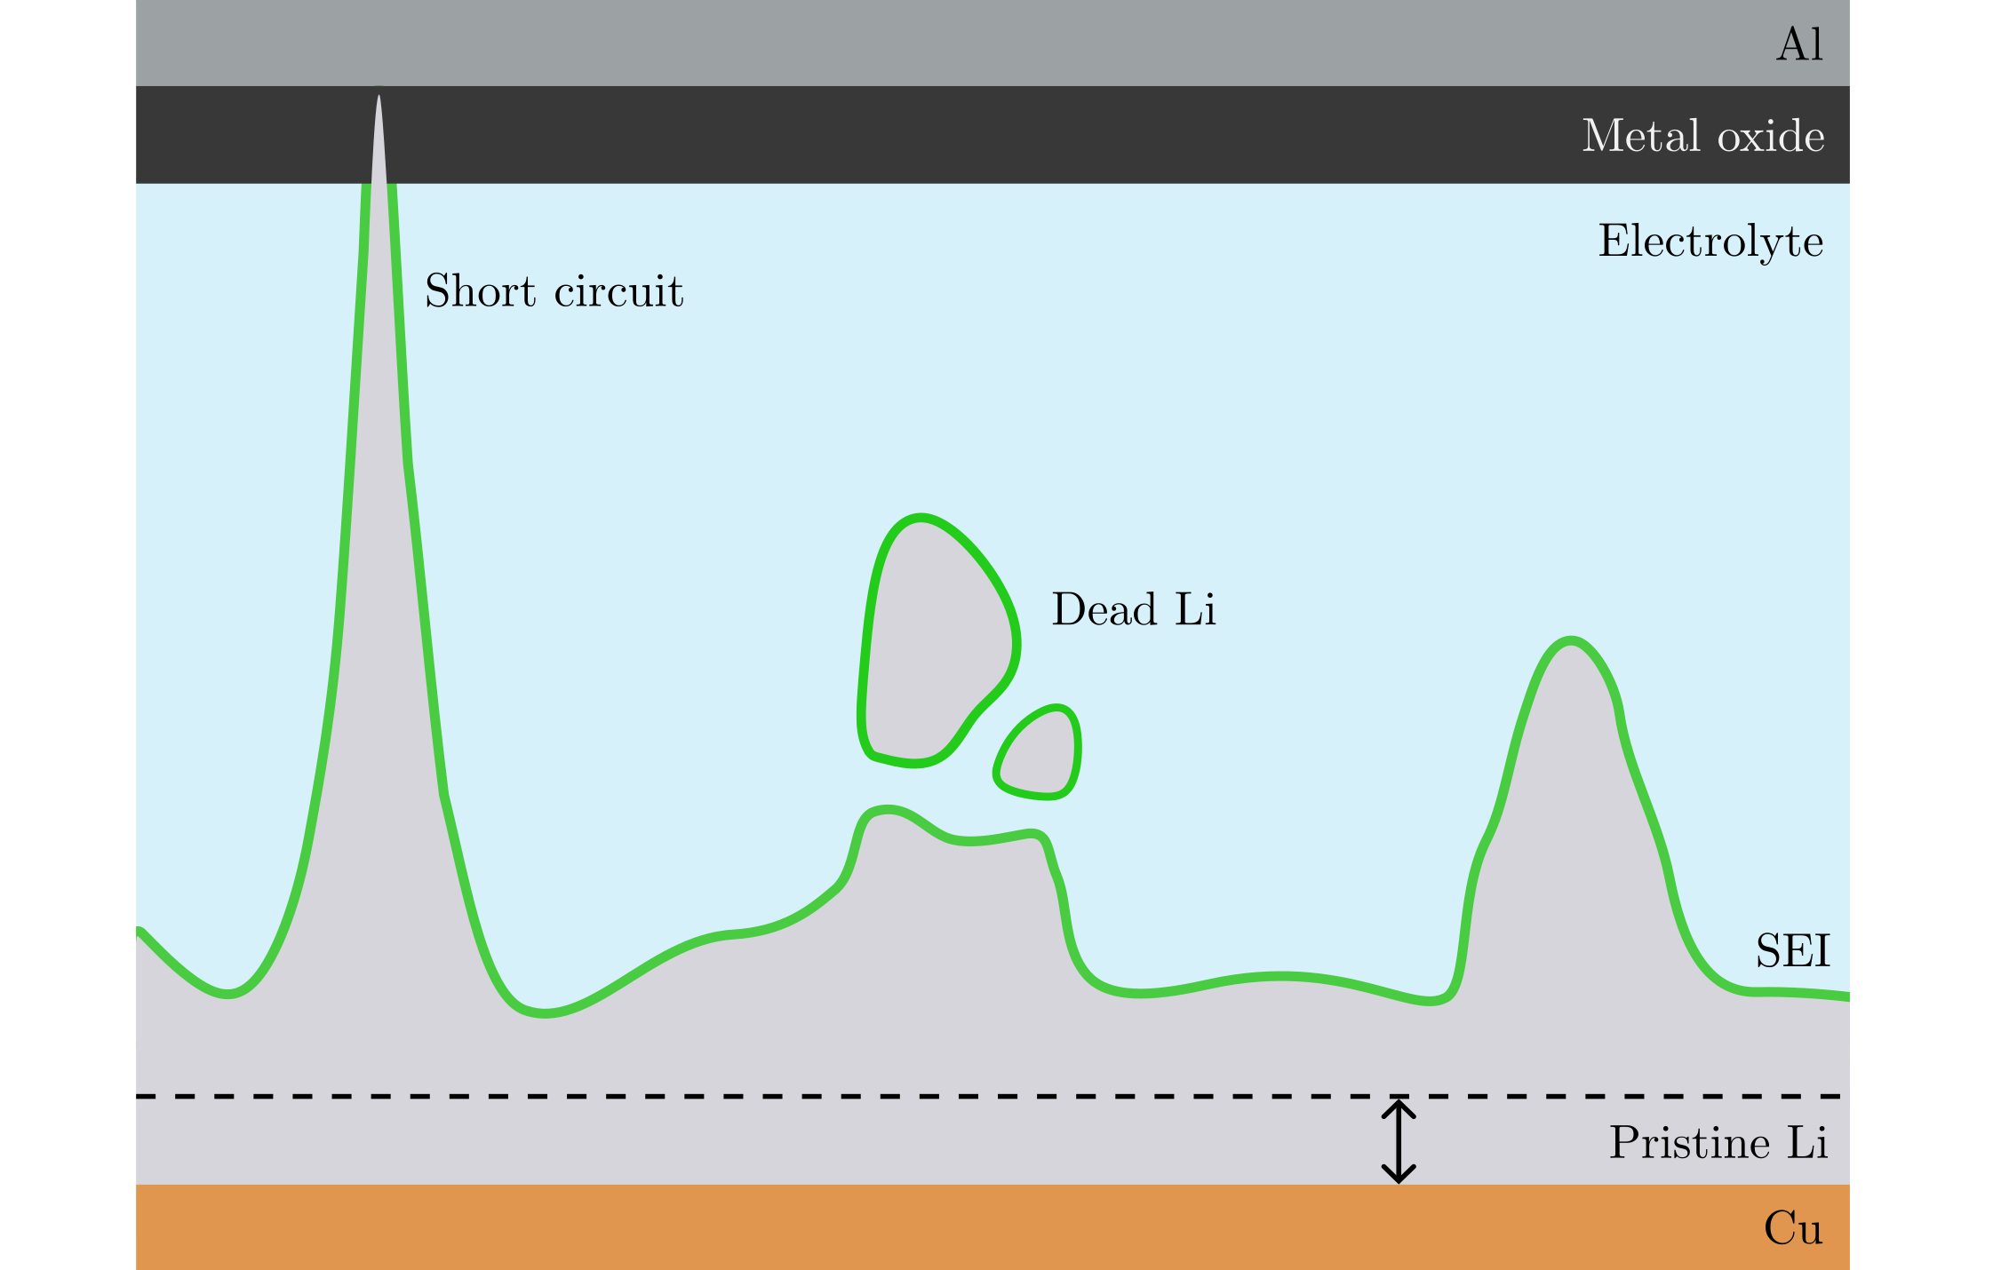
Non-uniform deposition problems
Notes:
if the SEI covers a piece of Li, it becomes electronically isolated and ‘’dead’’ as it can no longer contribute to the battery charge.
This lowers the lifetime of the battery.

Slide 14
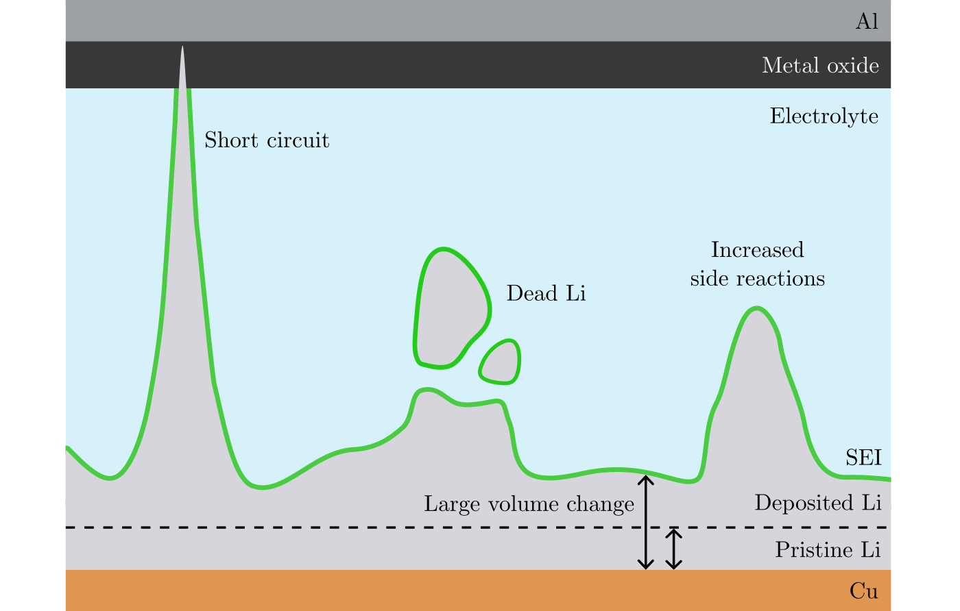
Non-uniform deposition problems
Notes:
Also, the difference in volume between the deposited and the pristine Li induces mechanical stress, which can crack the SEI.
This exposes fresh Li to the electrolyte, and more SEI is formed which consumes Li.
In short, non-uniform deposition is a safety risk [short circuit], and lowers the performance of the battery by creating dead Li [dead Li] and extra SEI.
So this is bad, how can it be avoided?

Slide 15
Purpose of this thesis
Notes:
To avoid non-uniform deposition, the first step – nucleation, must be well understood. …

Slide 16
Purpose of this thesis
Investigate the nucleation – the first step in deposition.
Notes:
By understanding nucleation better, ways of achieving more uniform deposition can be found.
I have used …

Slide 17
Purpose of this thesis
Investigate the nucleation – the first step in deposition.
Electrochemical measurements and scanning electron microscope.
Notes:
To investigate this I’ve done electrochemical measurements, and taken scanning electron microscope (SEM) images of Li on Cu.
How does deposition work?

Slide 18
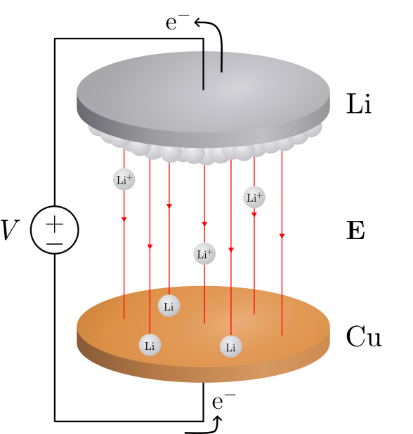
Deposition in a Li/Cu cell
Notes:
Here is a schematic of a Li/Cu cell. [drink]
Voltage difference → electrical field → excerts a force on positive charges, Li-ions.
Li atoms here can release their electrons [point].
The electrons moves along the circuit while the Li-ions moves toward the Cu.
Li-ions can recombine with electrons to form Li on the surface [point].

Slide 19
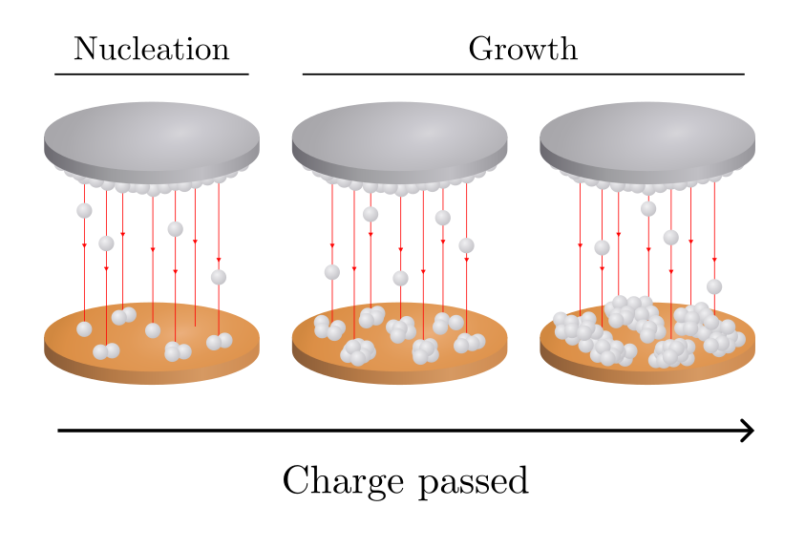
Deposition in a Li/Cu cell
Notes:
As more charge is passed – measured by the current in the circuit – more and more Li is deposited.

Slide 20
Deposition in a Li/Cu cell
Notes:
We identify two stages: nucleation in the beginning and then growth.

Slide 21
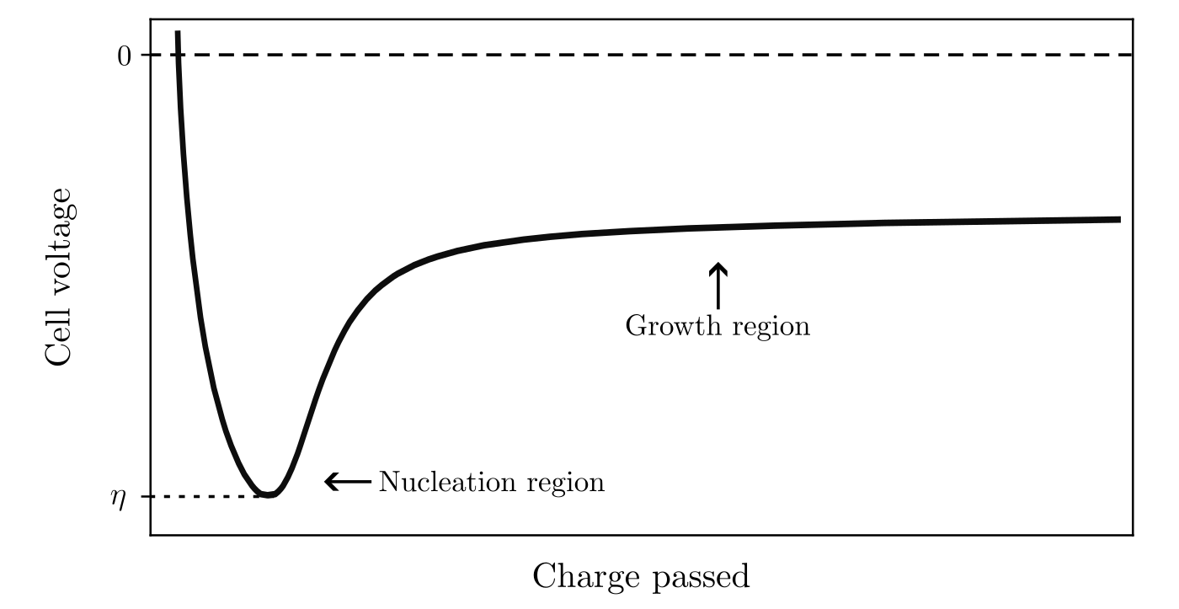
Deposition in a Li/Cu cell
Notes:
Let’s look at how the cell voltage varies with charge passed during deposition.

Slide 22
Deposition in a Li/Cu cell
Notes:
There is first a sharp drop in potential, reaching a lowest value of eta – this we will call the overpotential of nucleation.
Overpotential is how “deep” this peak is.
At this point of the curve, nucleation occurs.

Slide 23
Deposition in a Li/Cu cell
Notes:
Then, the voltage goes up and the nuclei grow.

Slide 24
Deposition in a Li/Cu cell
Notes:
And they continue to grow as more charge get passed.
So, the focus of this thesis is on the nucleation [point].
What is nucleation?

Slide 25
Nucleation
Notes:
Nucleation is the first step in forming a new phase within a substance.

Slide 26
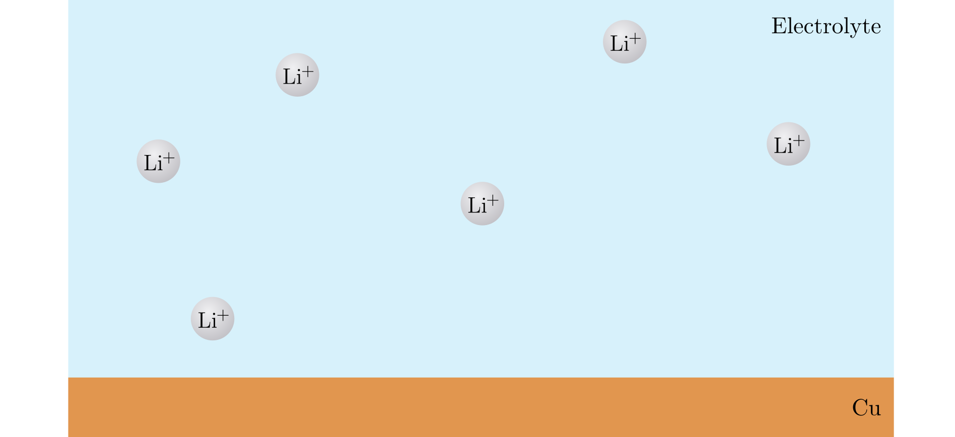
Nucleation
Notes:
In our case, imagine Li-ions in a solution – a liquid.

Slide 27
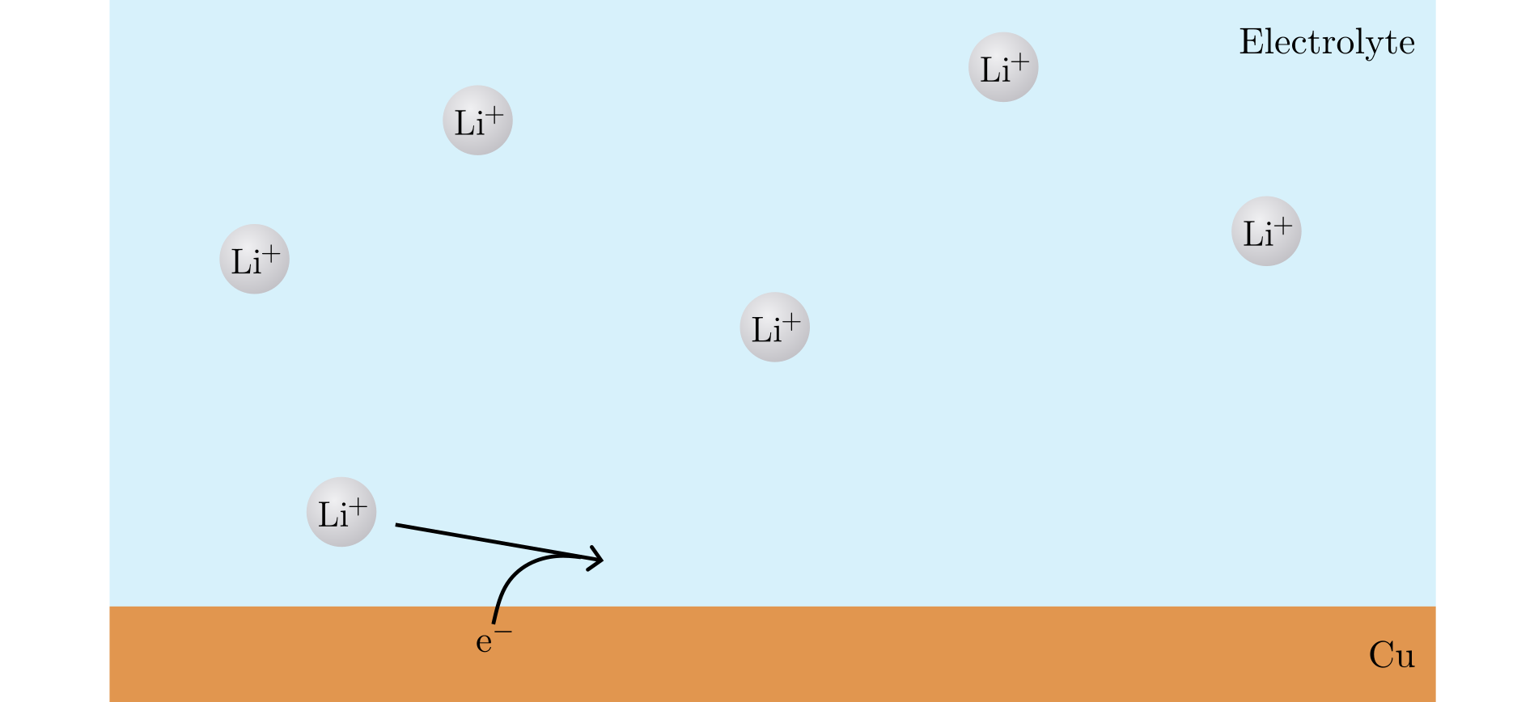
Nucleation
Notes:
A Li+ ion can take up an electron and …

Slide 28
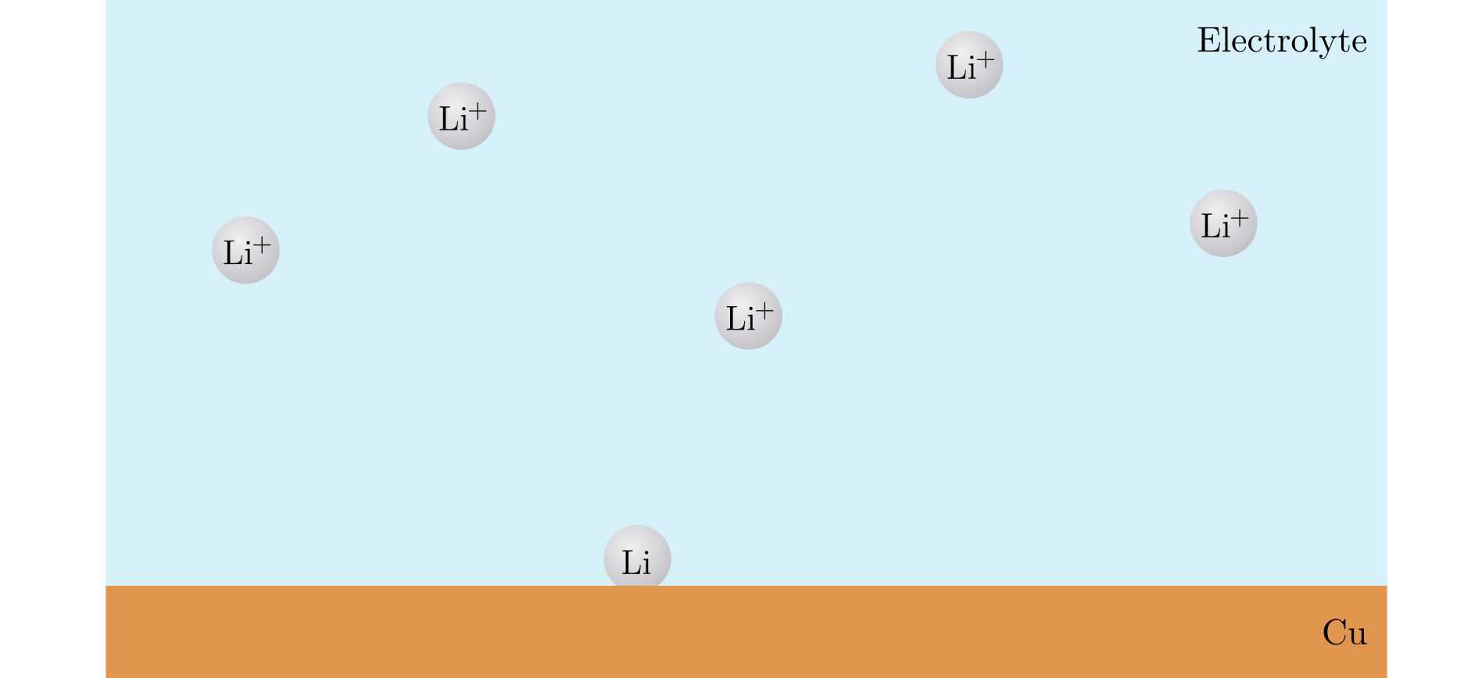
Nucleation
Notes:
Become a Li atom on the Cu surface.

Slide 29
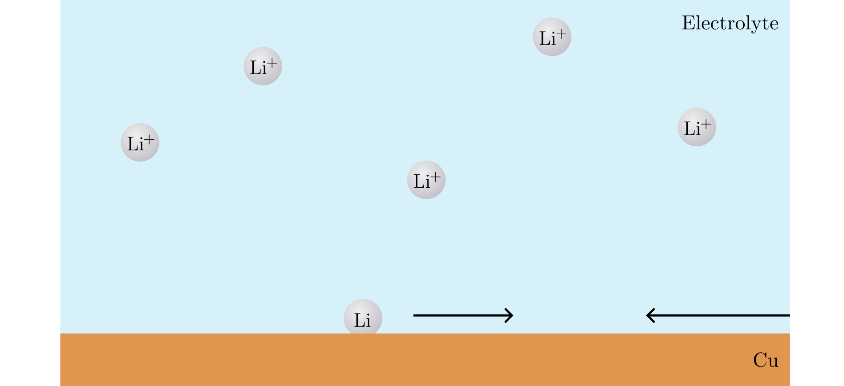
Nucleation
Notes:
If several Li atoms come together …

Slide 30
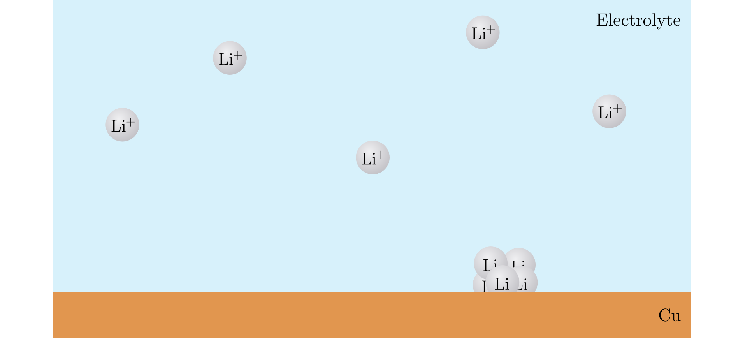
Nucleation
Notes:
A small cluster is formed.

Slide 31
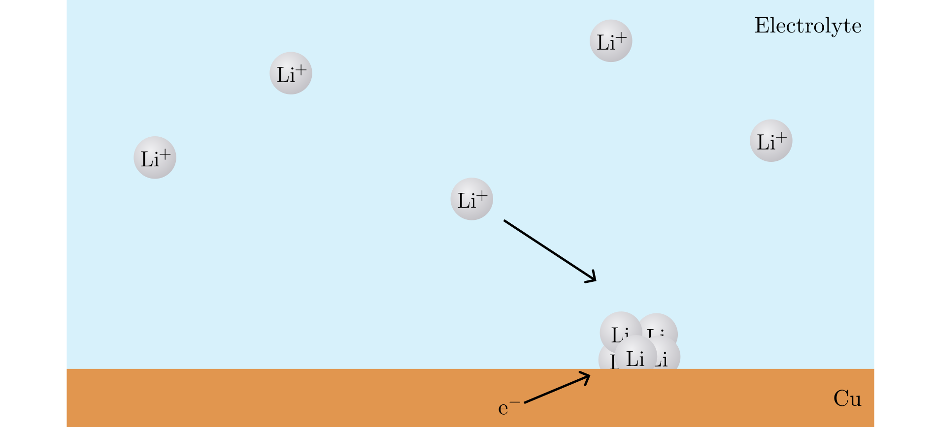
Nucleation
Notes:
As more Li gets added to the cluster…

Slide 32
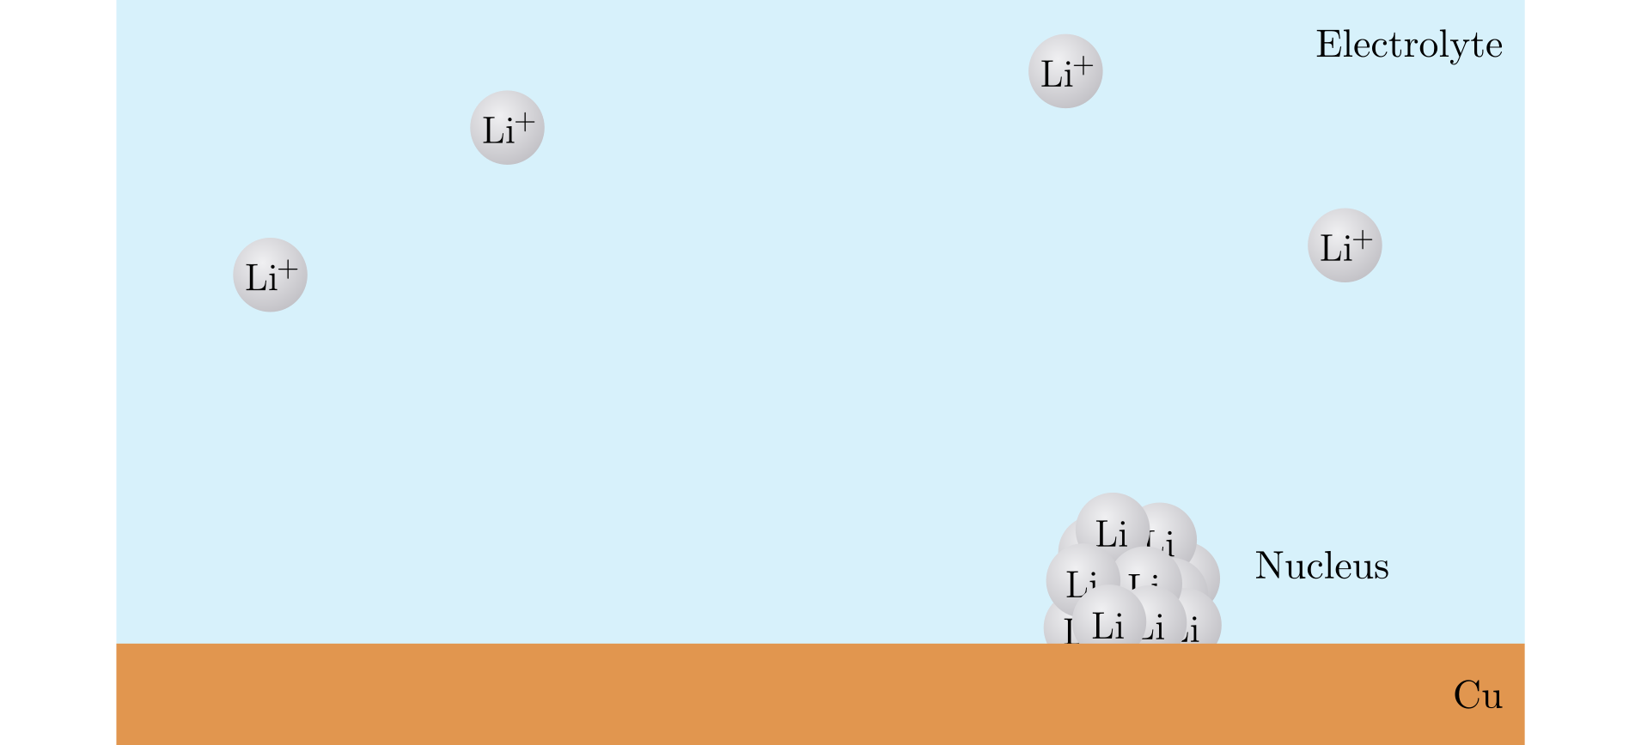
Nucleation
Notes:
Eventually a nucleus is formed.
This formation of the new SOLID phase from the LIQUID, is called nucleation.
It is useful to model this with theory.

Slide 33
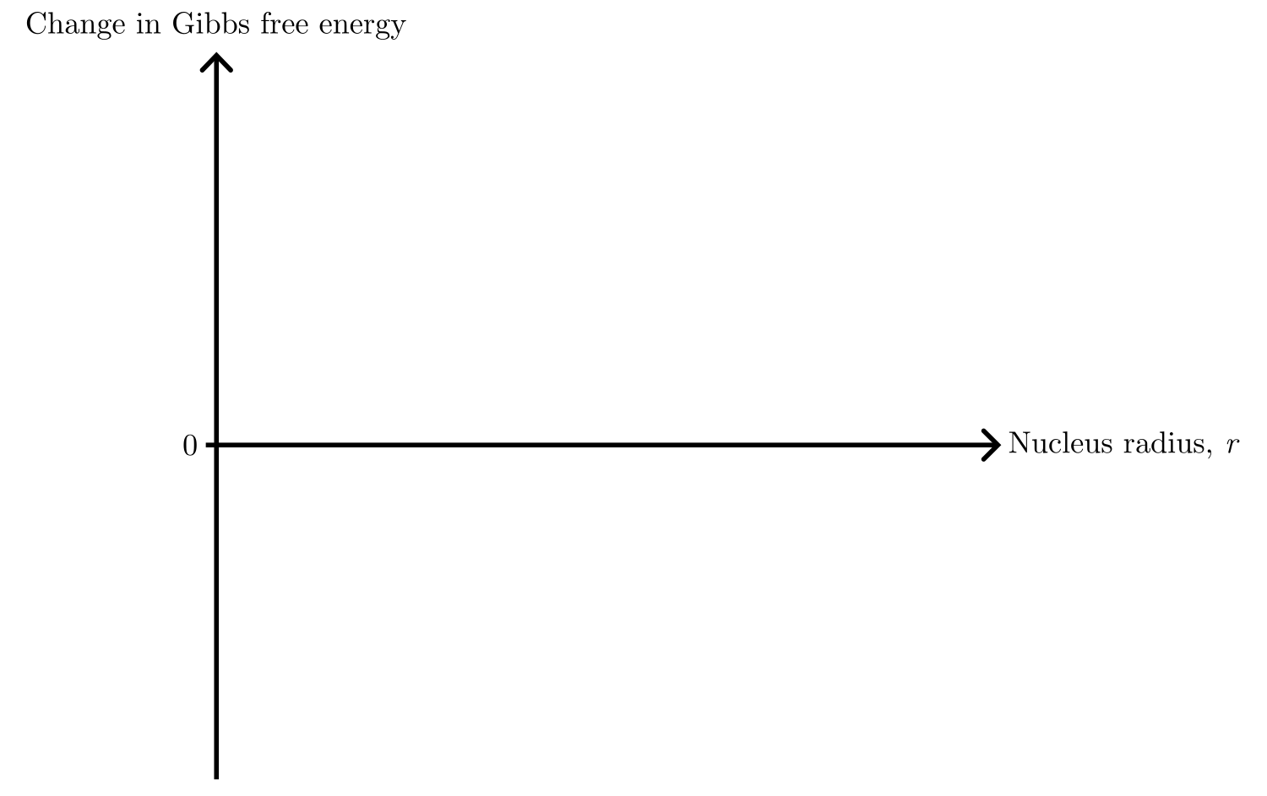
Nucleation theory
Notes:
Nucleation is modelled by looking at the change in Gibbs free energy of the system as function of nucleus radius.
Here, we area assuming a spherical nucleus.

Slide 34
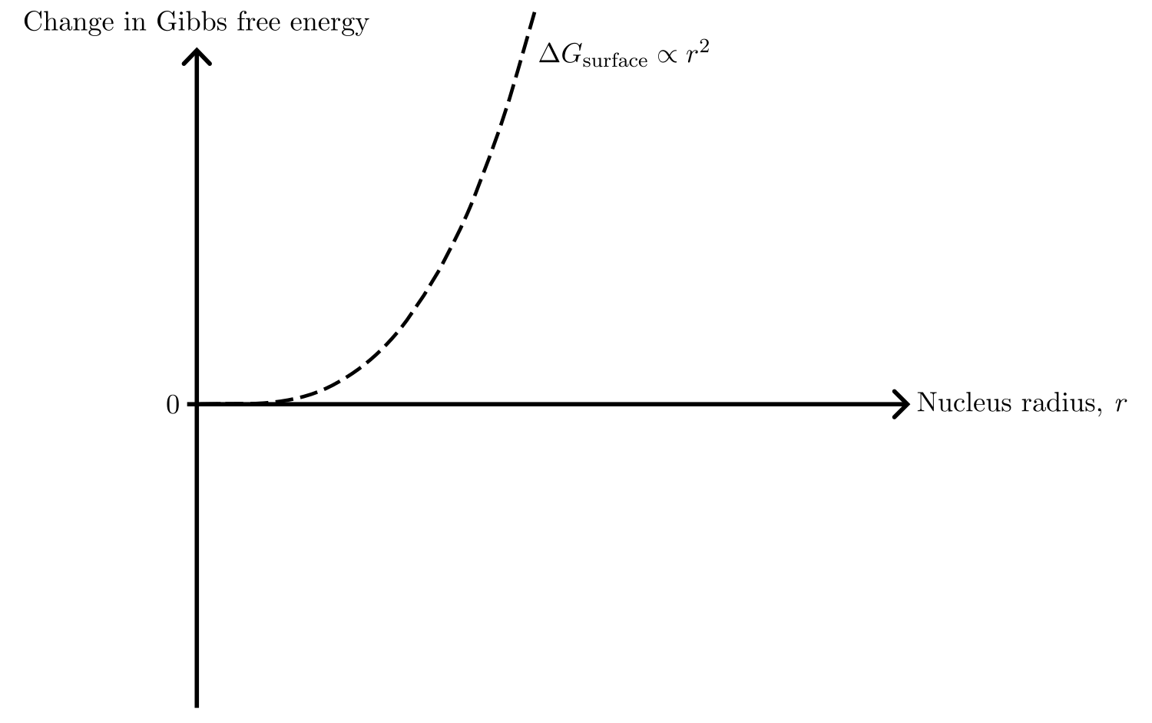
Nucleation theory
Notes:
To form the new phase, there is a cost for creating surface area.
It grows as r².

Slide 35
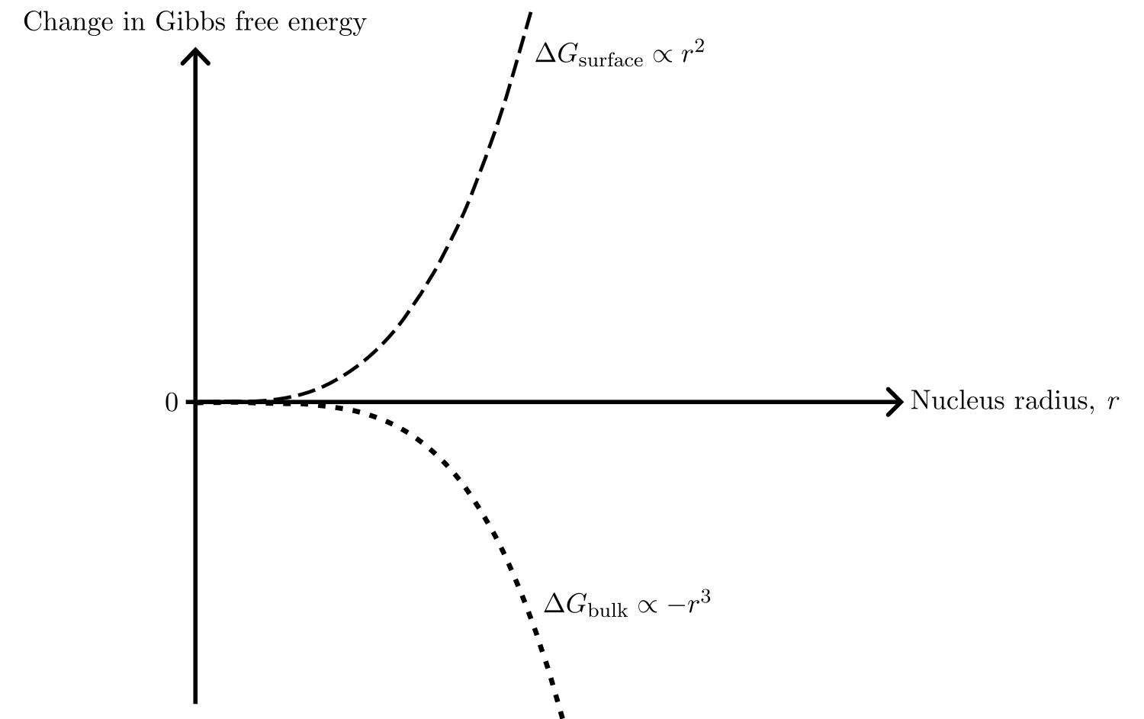
Nucleation theory
Notes:
At the same time, there is a gain in energy from creating bulk, scaling as –r³.
The sum of these …

Slide 36
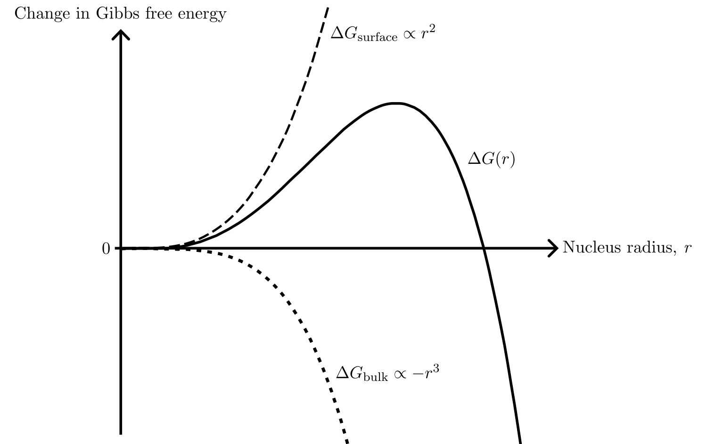
Nucleation theory
Notes:
DeltaG, is the change in Gibs free energy for creating a nucleus of a certain size r.
It costs energy to build a nucleus, up until this point…

Slide 37
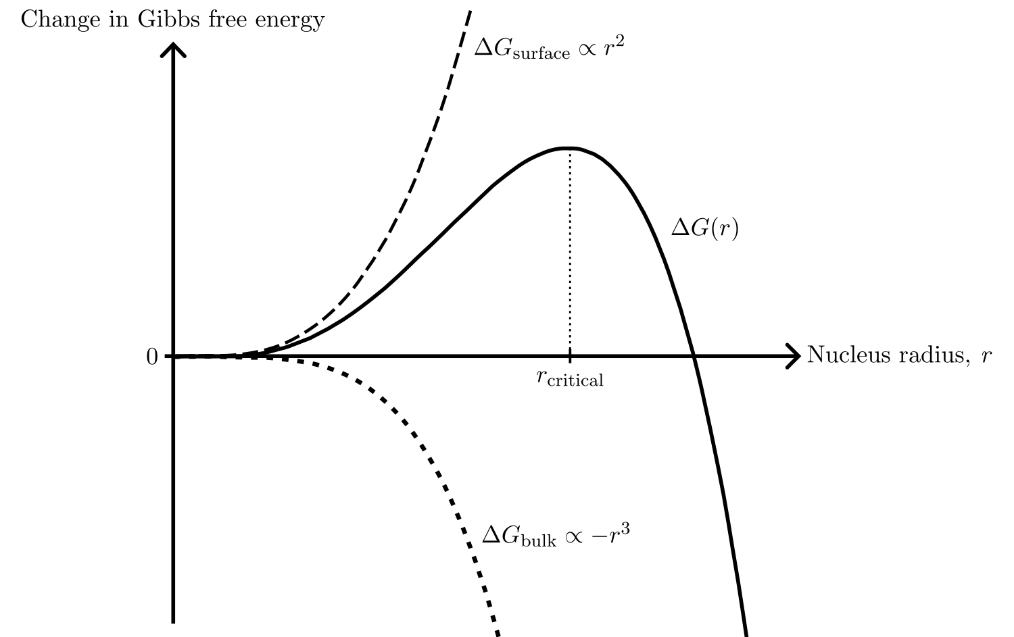
Nucleation theory
Notes:
This is the critical radius, where the nucleus start to grow spontaneously as this lowers the overall energy of the system.
But to get to that point, there is an energy barrier …

Slide 38
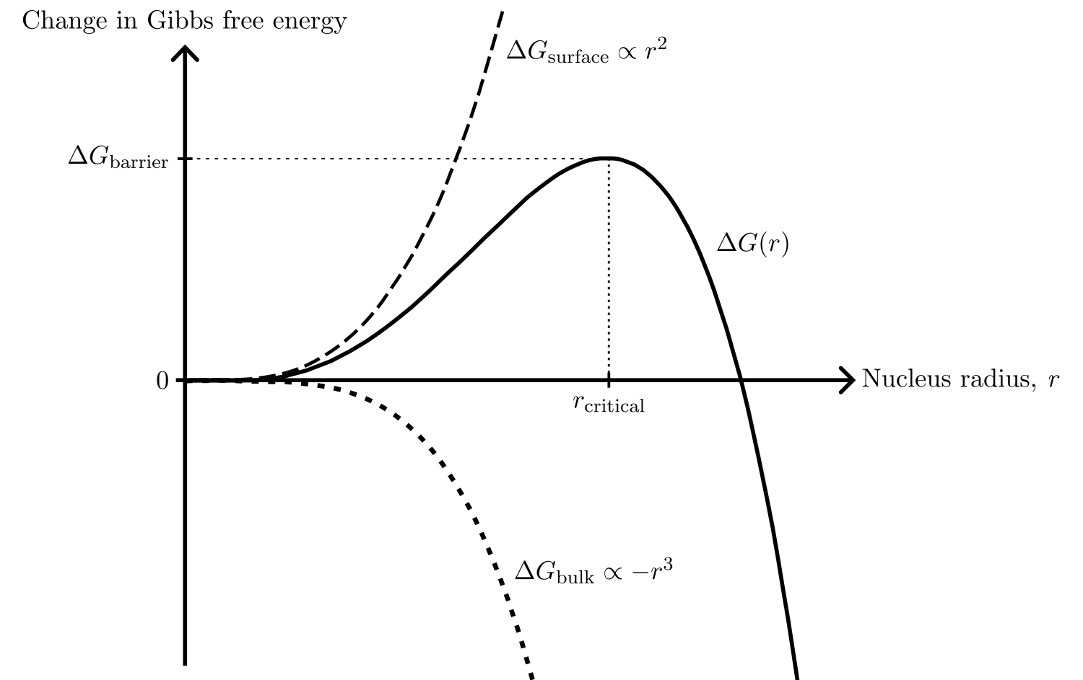
Nucleation theory
Notes:
Delta G_barrier, which needs to be overcome.
And we saw the effect of this barrier…

Slide 39
Nucleation theory
Notes:
in the deposition curve, with the sharp drop in the voltage.
This overpotential is energy we put in to drive the nucleation.

Slide 40
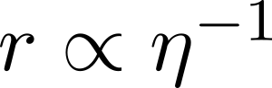
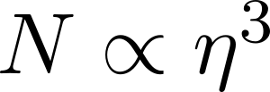
Nucleation theory
Notes:
From nucleation theory, one can show that the size of the nucleus r is inversely proportional to the overpotential eta, and that the number of nuclei per area N is proportional to the third power of the overpotential.
What does this mean?

Slide 41
Nucleation theory
Notes:
This means that…

Slide 42
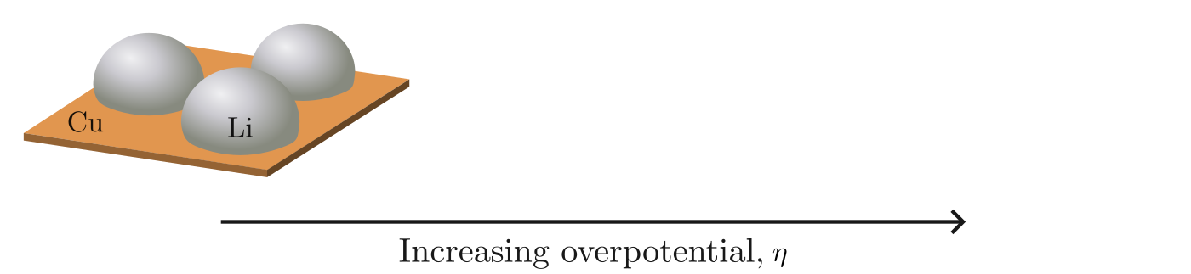
Nucleation theory
Notes:
For low overpotential: large and few nuclei.

Slide 43
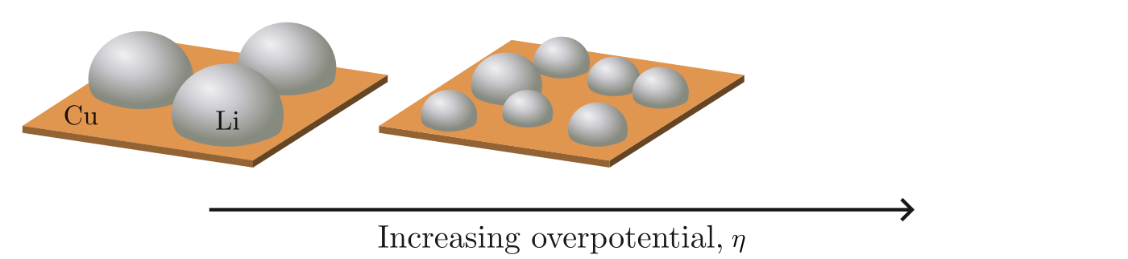
Nucleation theory
Notes:
For increasing overpotential…

Slide 44
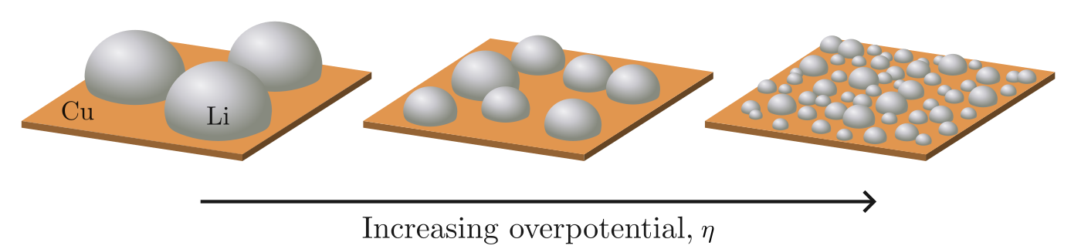
Nucleation theory
Notes:
smaller nuclei but more per area.
Thus, the overpotential influences the size and number of nuclei.
One can imagine that this [point] leads to more even deposition compared to this [point].
[drink]

Slide 45
Scientific questions in this thesis
The shape of the deposition curve
Degree of passivation of the Cu surface
Deposition current
Distribution of the nuclei
Pressure distribution between the Li and Cu
Notes:
This thesis will focus on how the shape of the deposition curve, and how the distribution of the nuclei can be affected.

Slide 46
Scientific questions in this thesis
The shape of the deposition curve
Degree of passivation of the Cu surface
Deposition current
Distribution of the nuclei
Pressure distribution between the Li and Cu
Notes:
The shape will be investigated by looking at the passivation and deposition current.

Slide 47
Scientific questions in this thesis
The shape of the deposition curve
Degree of passivation of the Cu surface
Deposition current
Distribution of the nuclei
← Electrochemical measurements
Notes:
For this, I’ve taken electrochemical measurements.

Slide 48
Scientific questions in this thesis
The shape of the deposition curve
Degree of passivation of the Cu surface
Deposition current
Distribution of the nuclei
Pressure between the Li and Cu
← Electrochemical measurements
Notes:
We will look at how the pressure between the Li and Cu affects the distribution of the nuclei.

Slide 49
Scientific questions in this thesis
The shape of the deposition curve
Degree of passivation of the Cu surface
Deposition current
Distribution of the nuclei
Pressure between the Li and Cu
← Electrochemical measurements
← Image Li nuclei using SEM
Notes:
For this, I’ve imaged Li nuclei using the SEM.
To have different pressures, we need different cell setups.

Slide 50
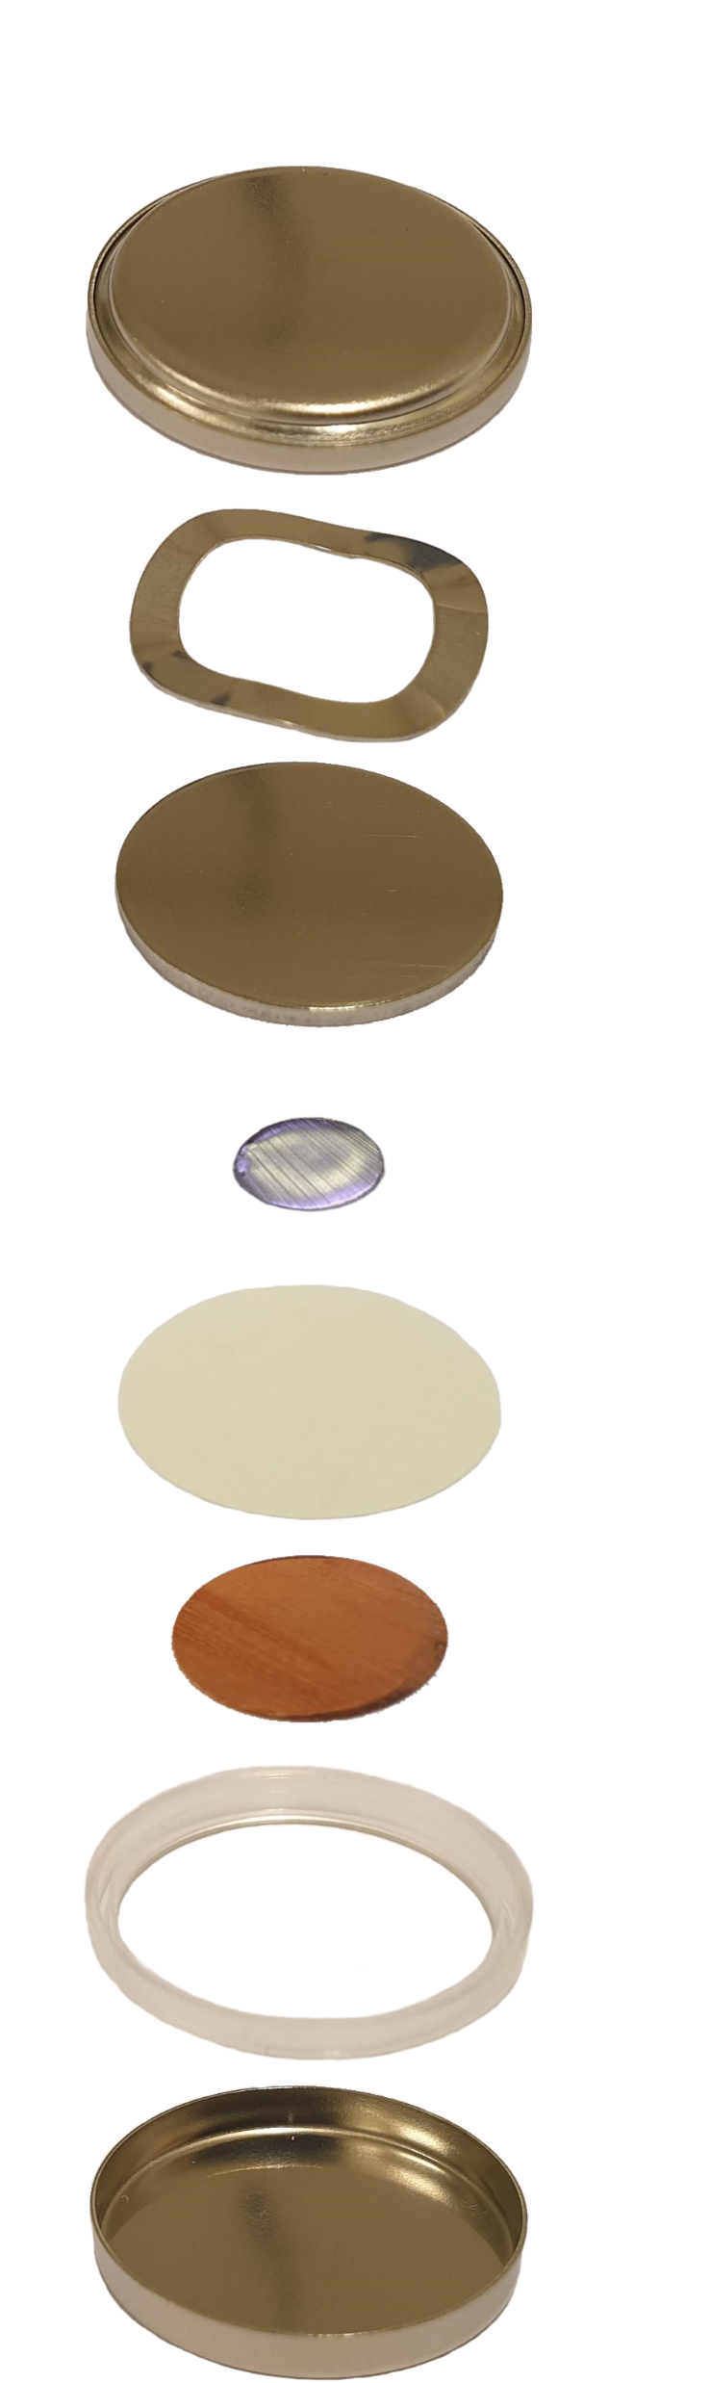
The C-cell
Cap
Spring
Spacer
Li
Separator
Cu
Gasket
Can
Notes:
First is the coin cell, or C-cell.
Note the parts. [pause]
Most important are, of course, the Li and Cu. The separator keeps them from touching, and the spring is also important.
During assembly, electrolyte is added to the separator and the parts are pushed together …

Slide 51
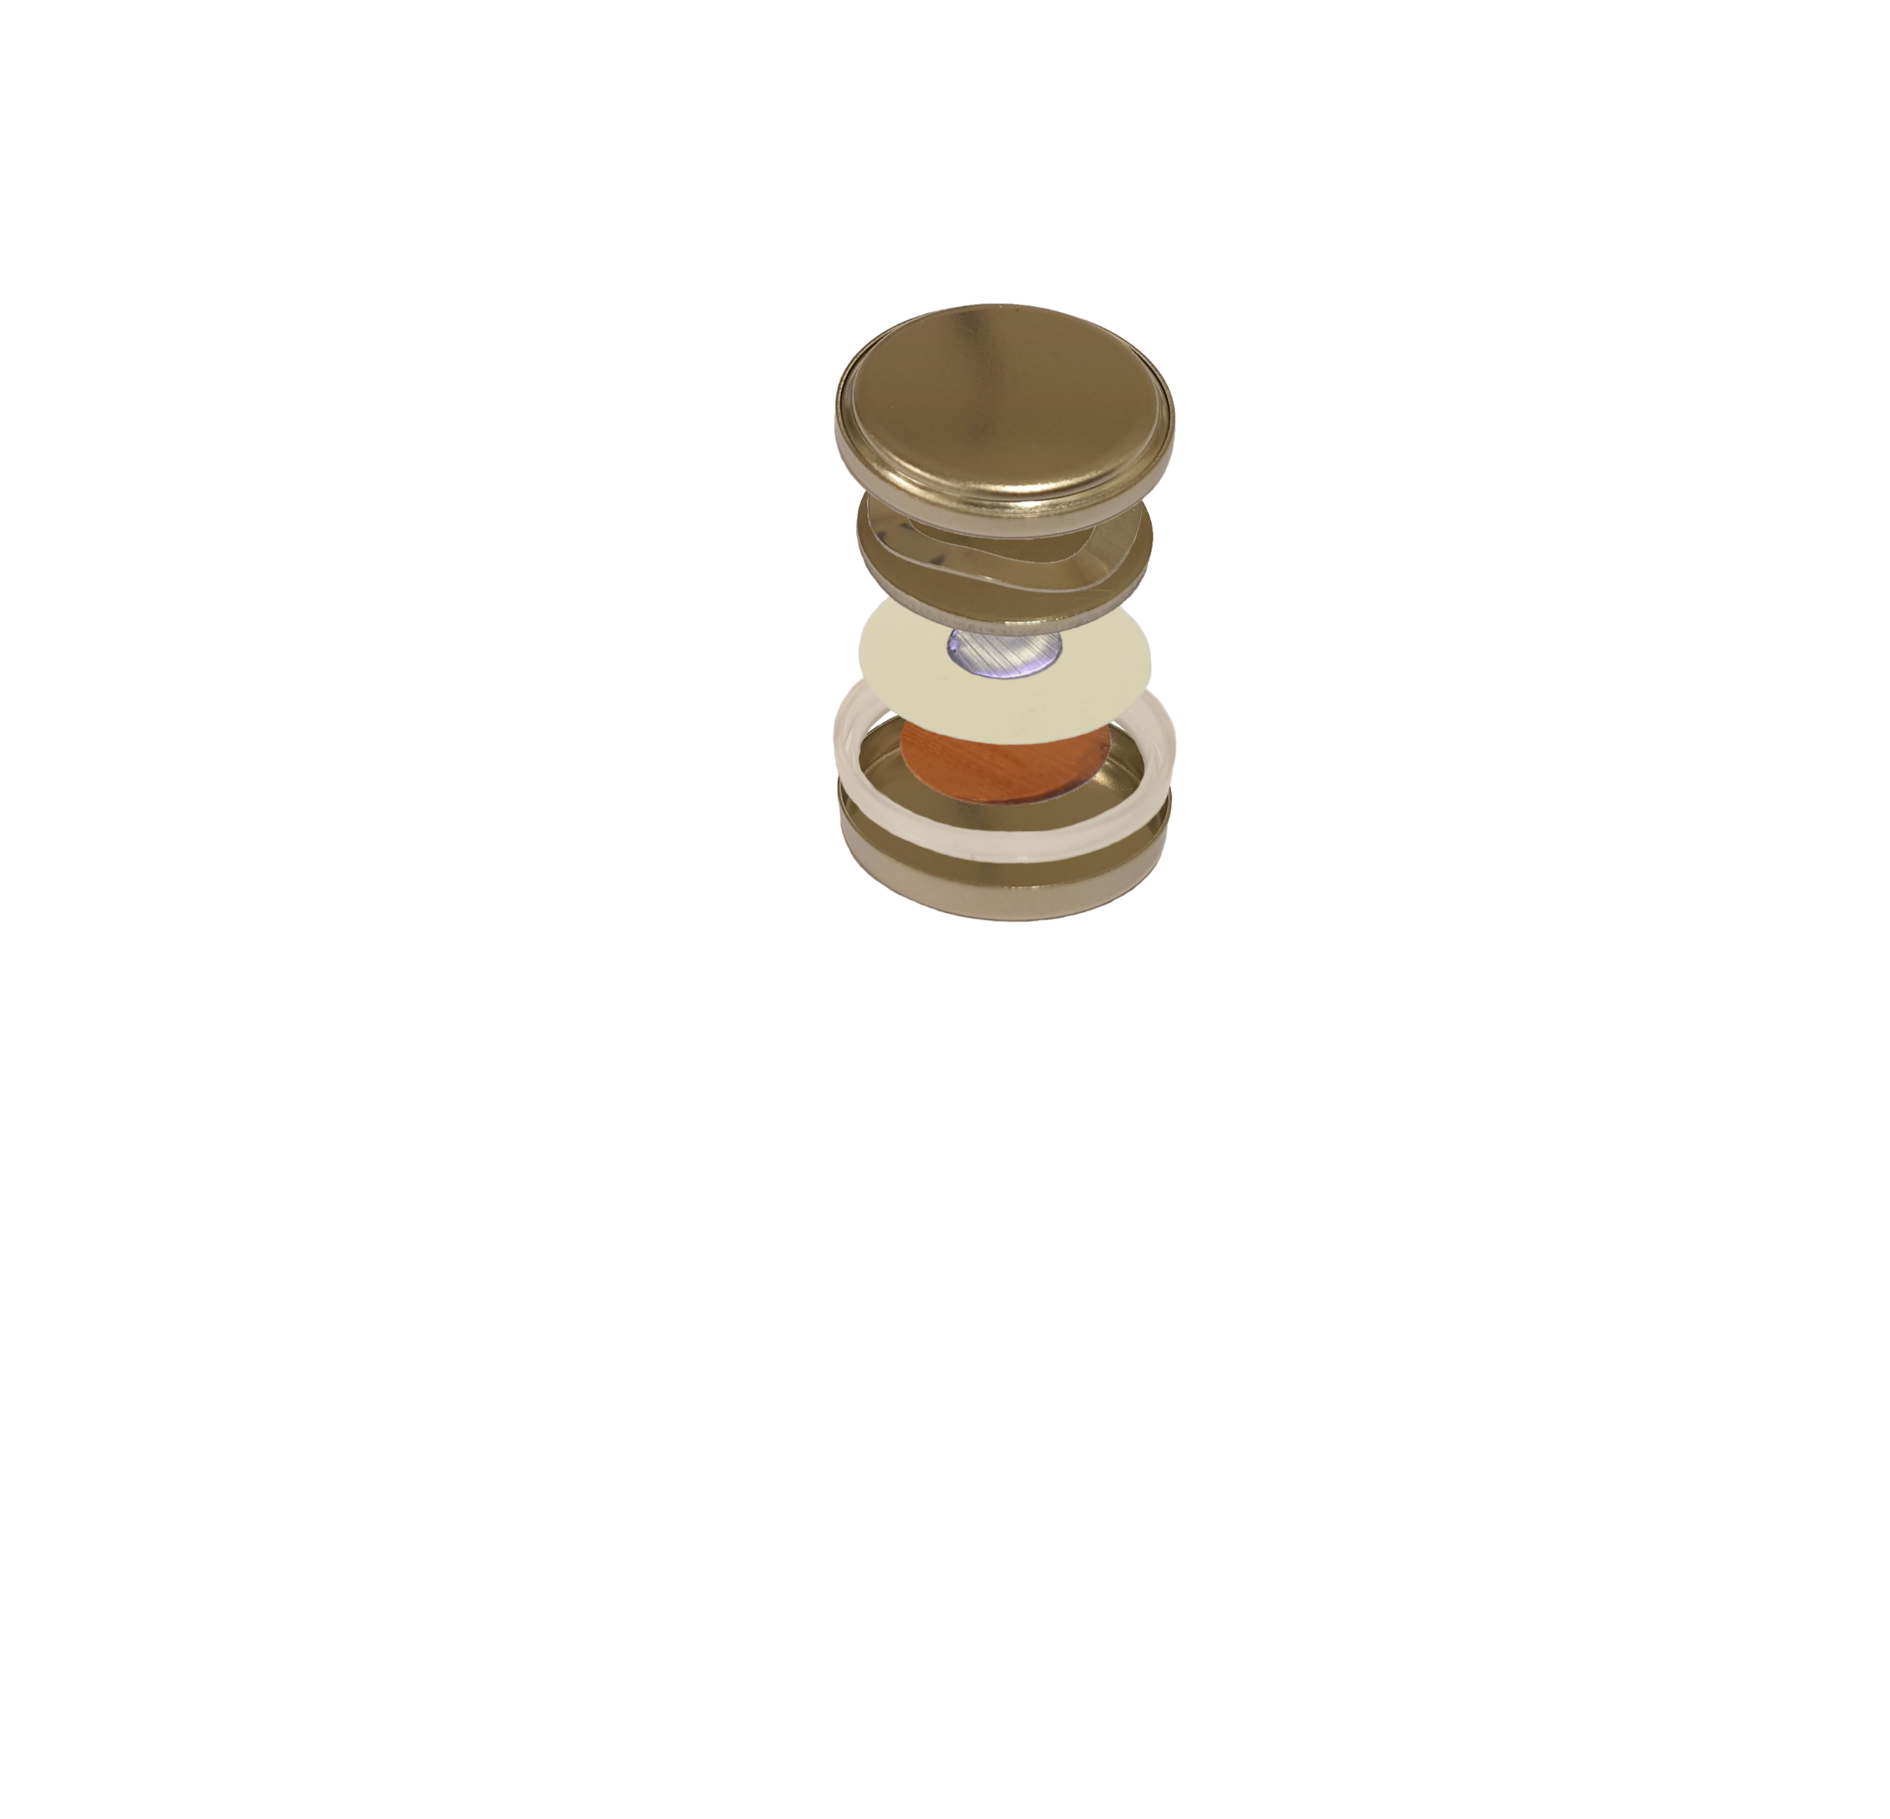
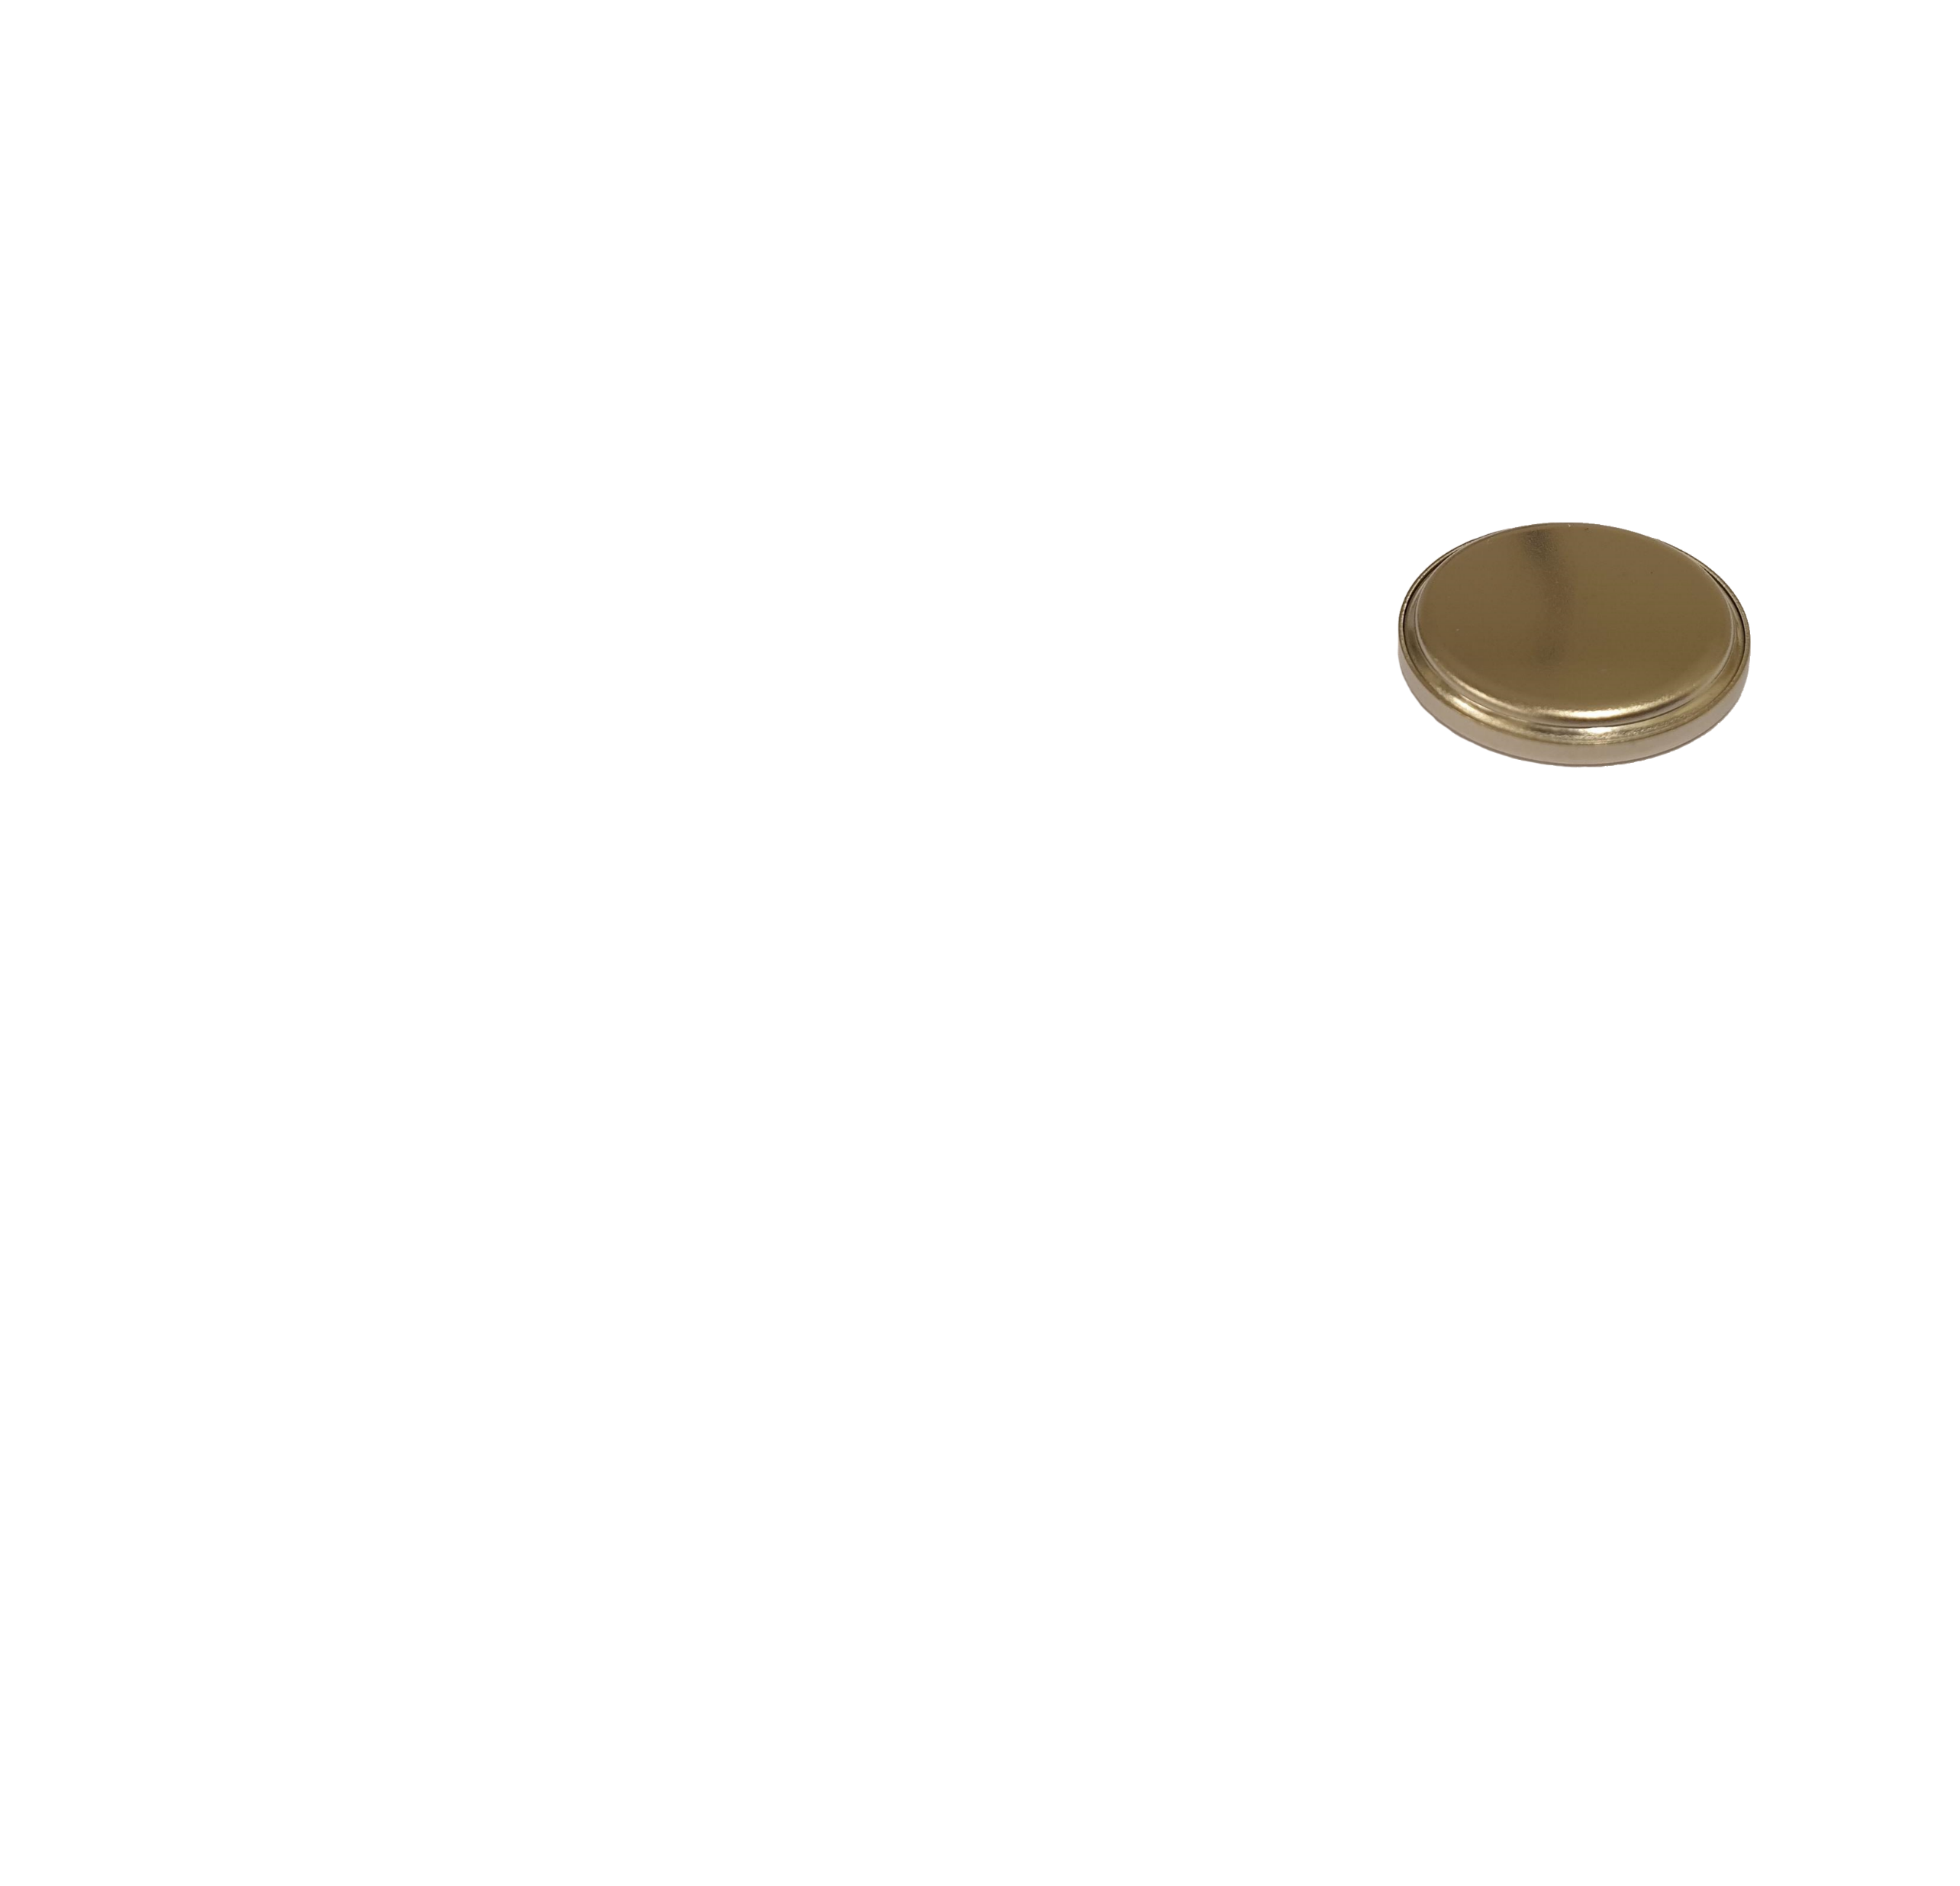
The C-cell
Cap
Spring
Spacer
Li
Separator
Cu
Gasket
Can
Notes:
Then place this in the machine …

Slide 52
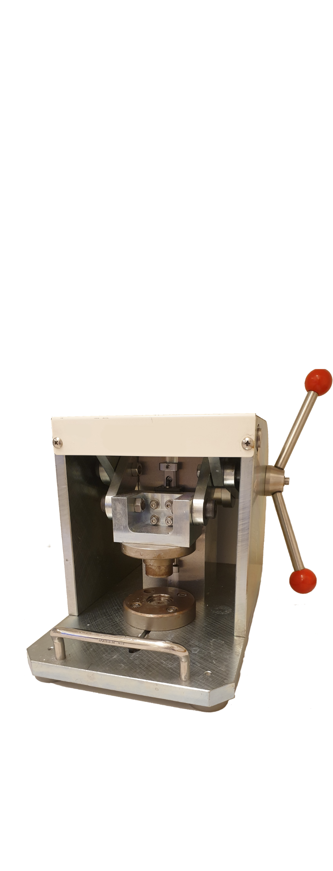
The C-cell
Cap
Spring
Spacer
Li
Separator
Cu
Gasket
Can
Notes:
and turn the handles [spin finger in circle] which …

Slide 53

The C-cell
Cap
Spring
Spacer
Li
Separator
Cu
Gasket
Can
Notes:
closes the cell by folding in the edges, and results in this.
Note that the spring now exerts a force in the cell, meaning there is pressure applied between the Li and Cu.
The other cell type, without pressure, is …

Slide 54
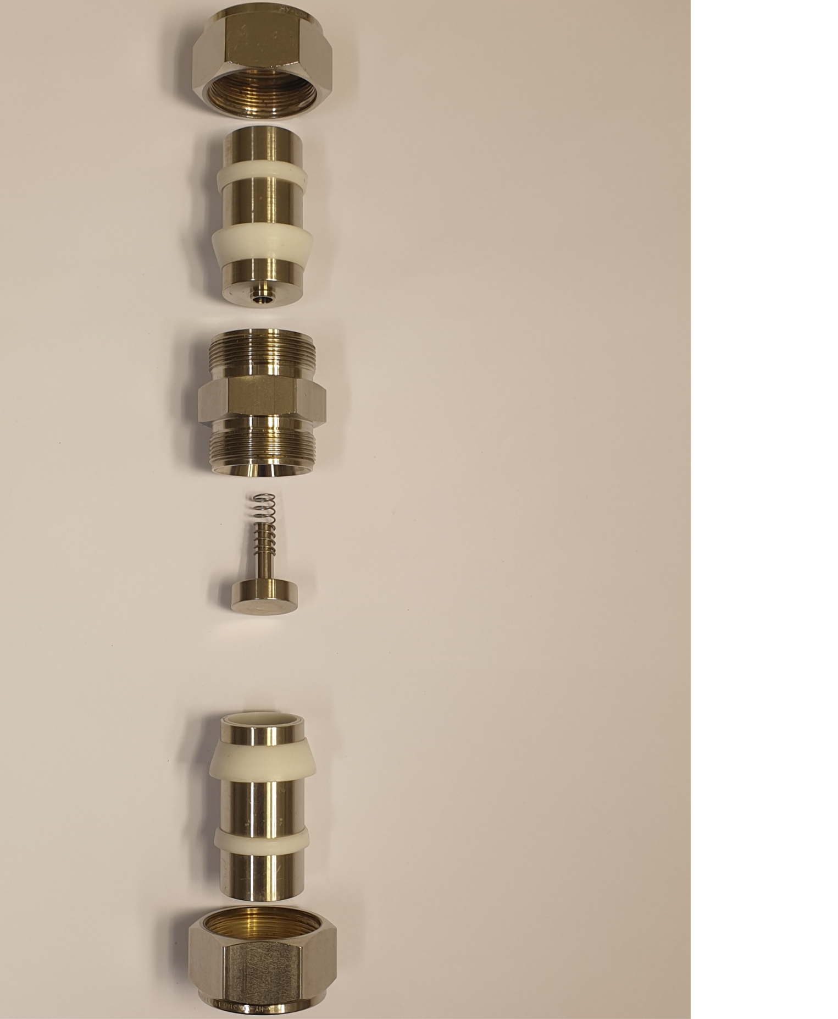
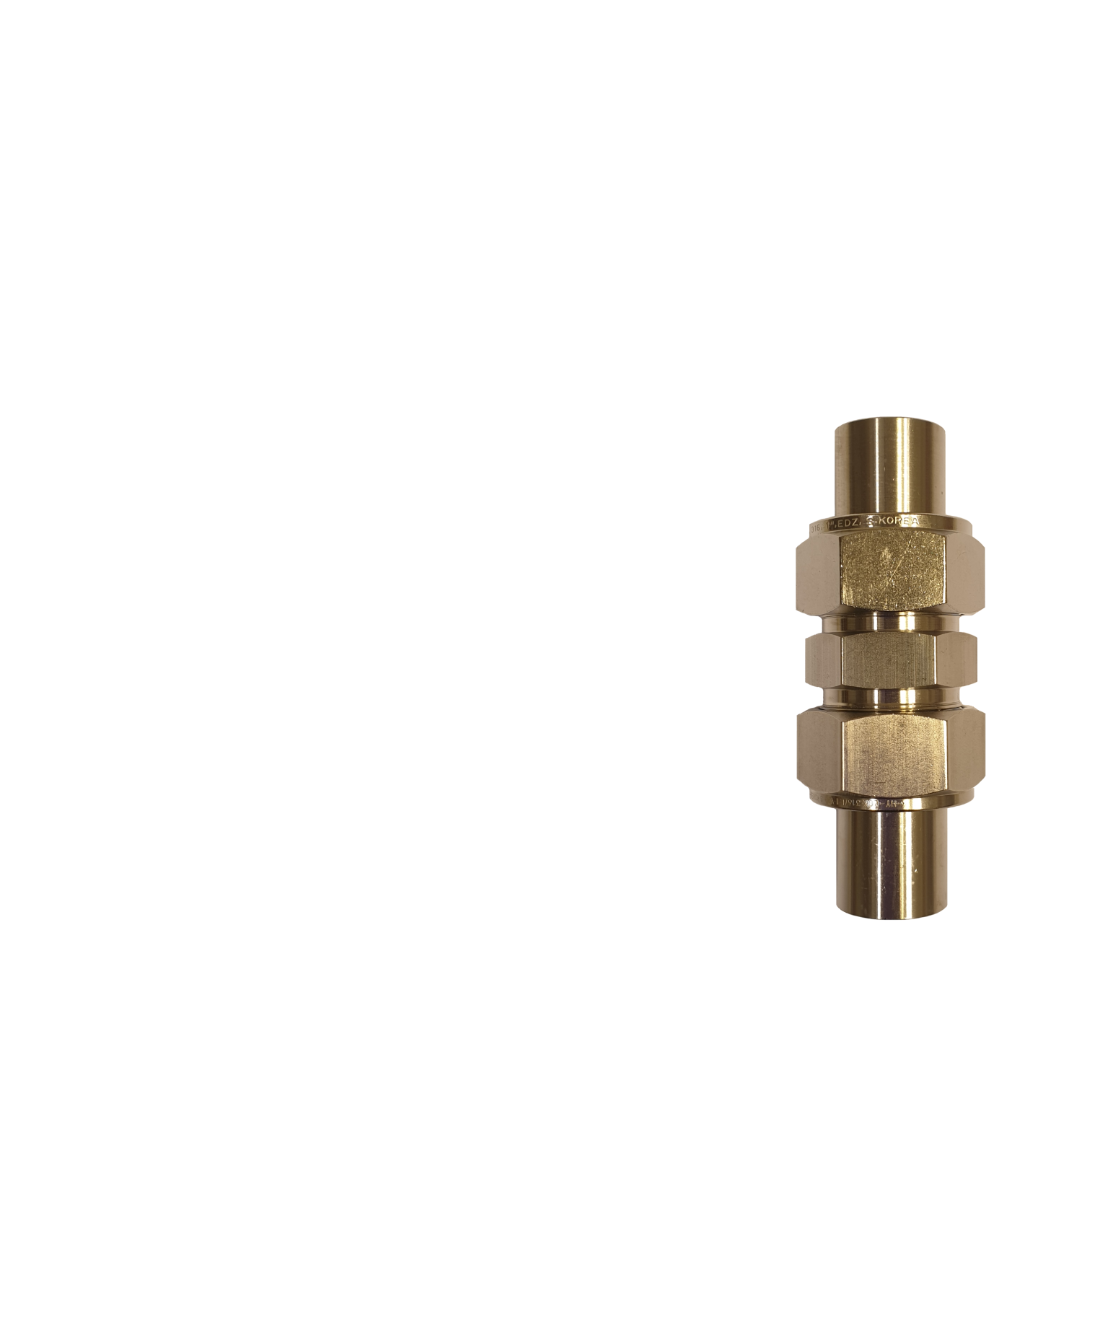

The I-cell
Nut
Metal rod
Sealing
rings
Main body
Spring
Spacer
Li
Separator
Cu

Slide 55
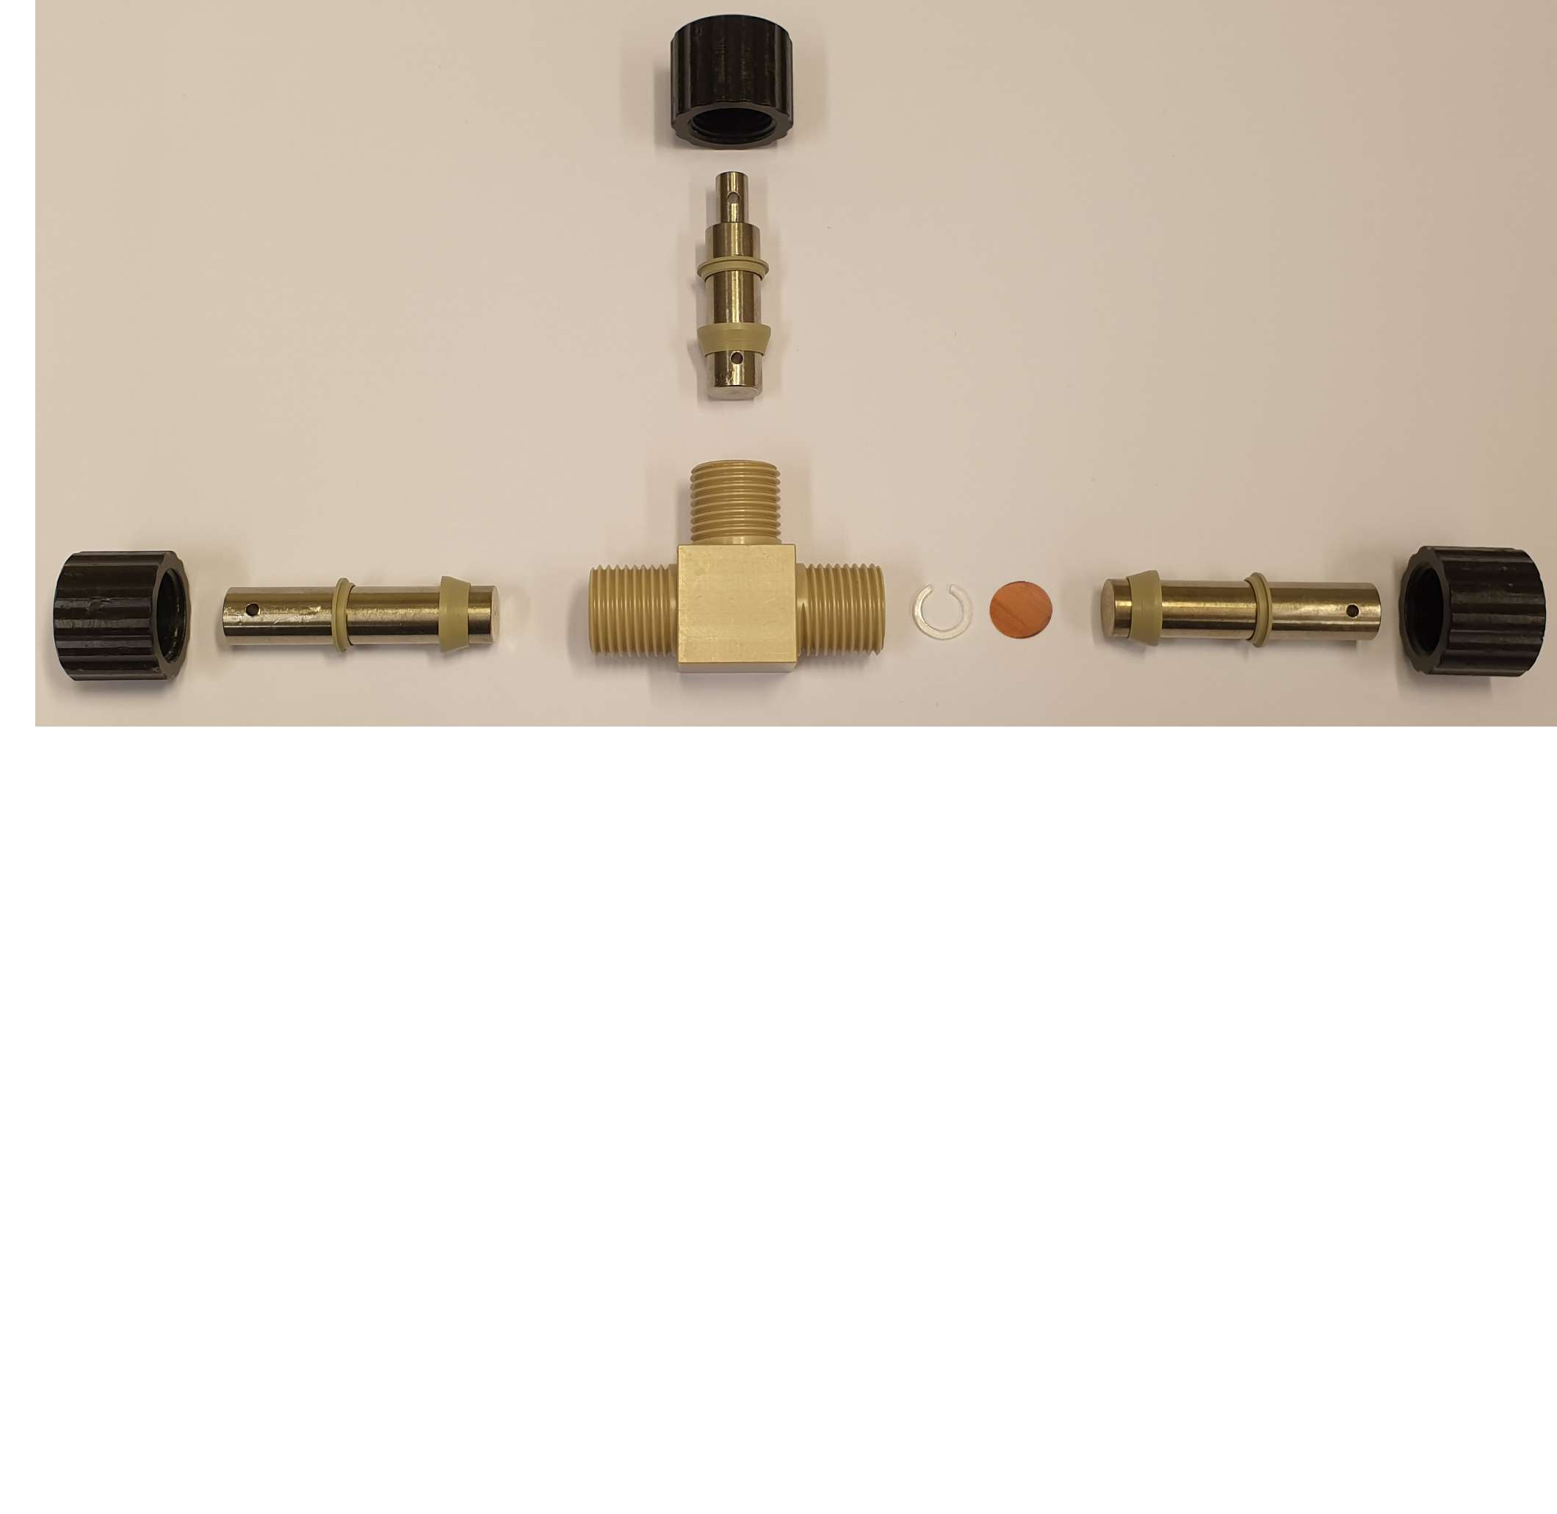

The T-cell
Nut
Metal rod
Sealing rings
Li
Main body
Spacer
Cu
Notes:
The T-cell, “T” because it has three metal rods attached to the main body in a T-shape. [pause]
Push the parts together, …

Slide 56
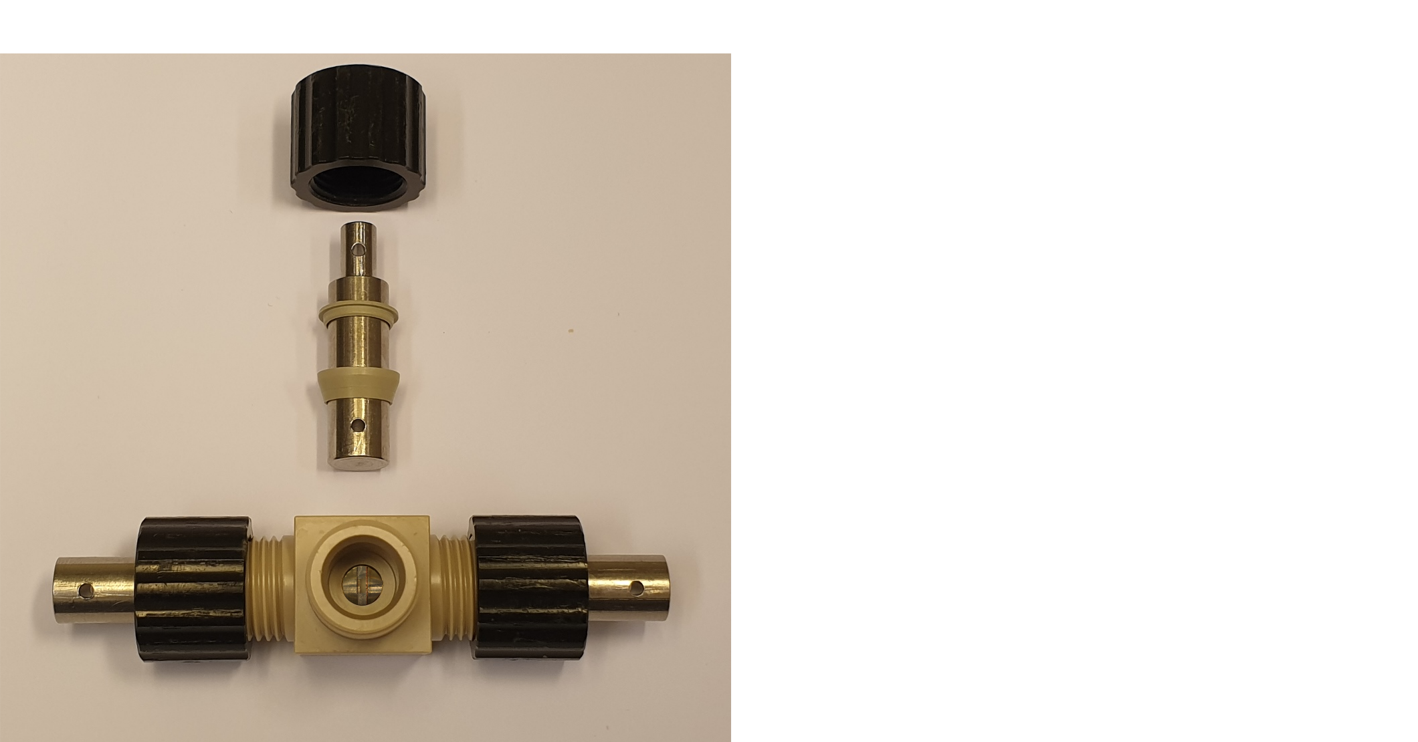
The T-cell
Notes:
And before putting in the last metal rod, electrolyte is added …

Slide 57
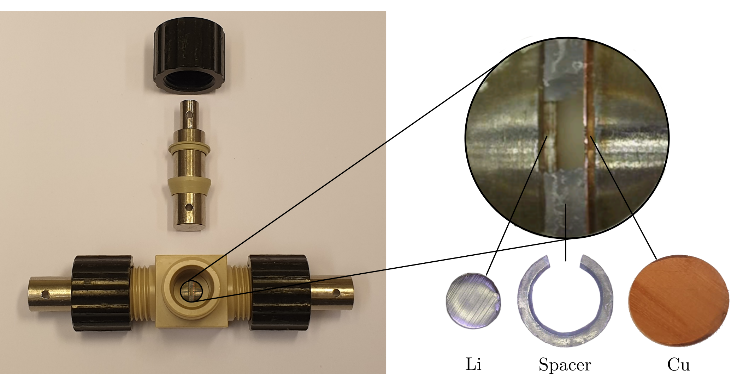
The T-cell
Notes:
Through this gap made in the spacer you can see in the zoom-in.
The spacer keeps a distance between the Li and Cu – so there is no applied pressure between them.

Slide 58
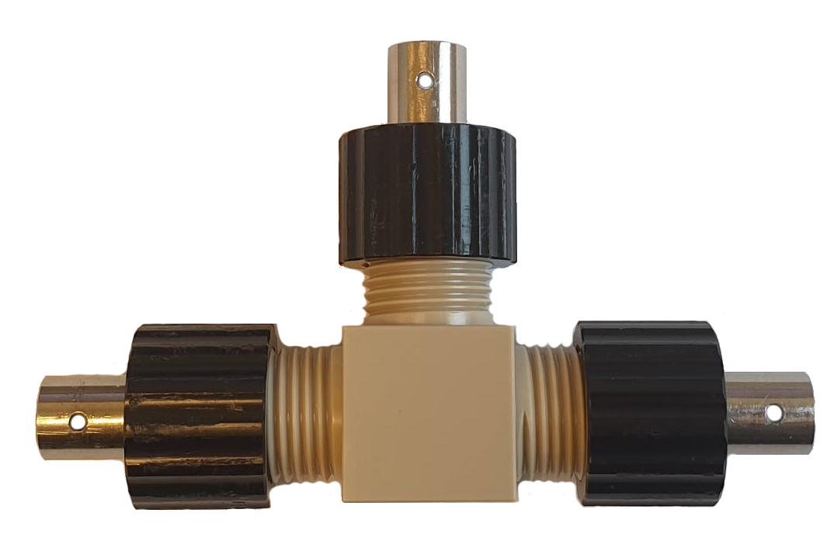
The T-cell
Notes:
The assembled cell looks like this.
=D
Now we can make cells, and connect them to an instrument that controls and measures voltage and current.
To get deposition, we must cycle them – or run a deposition protocol …

Slide 59
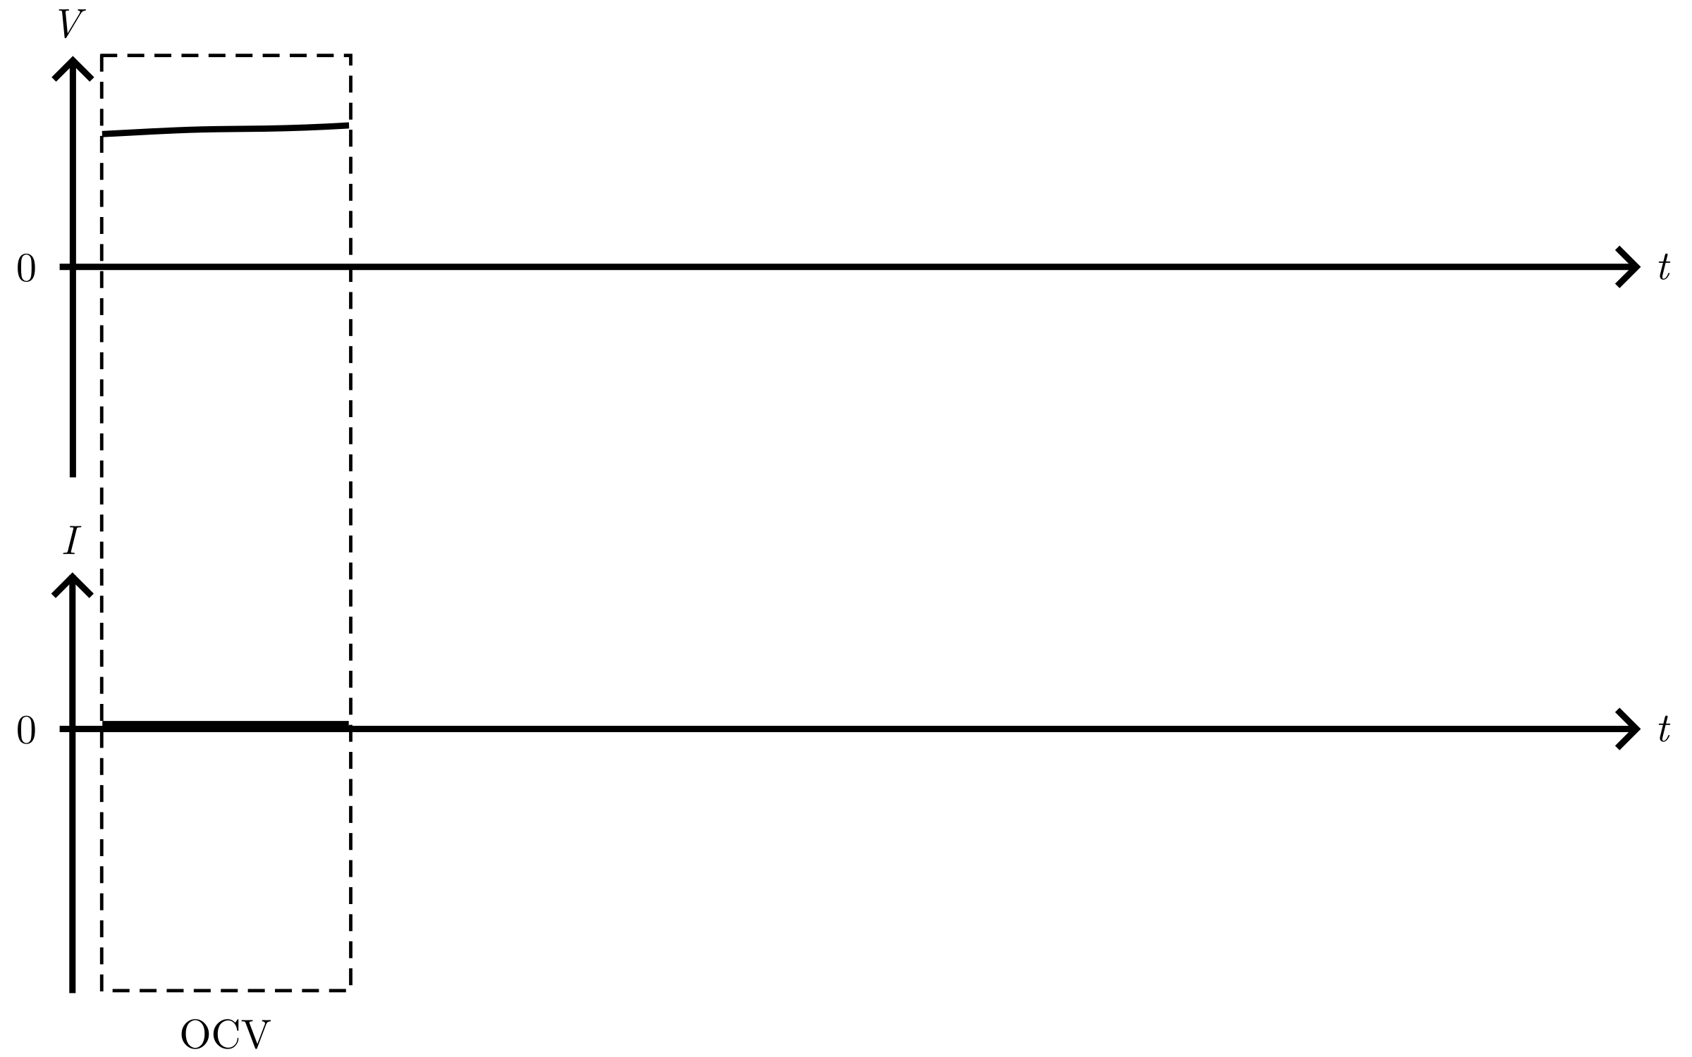
Deposition protocol
Notes:
This protocol is shown as the voltage and current as function of time.
3 parts

Slide 60
Deposition protocol
Notes:
The first part of the protocol is the open circuit voltage.
We check that the voltage of the cell is good, meaning it was assembled correctly.

Slide 61
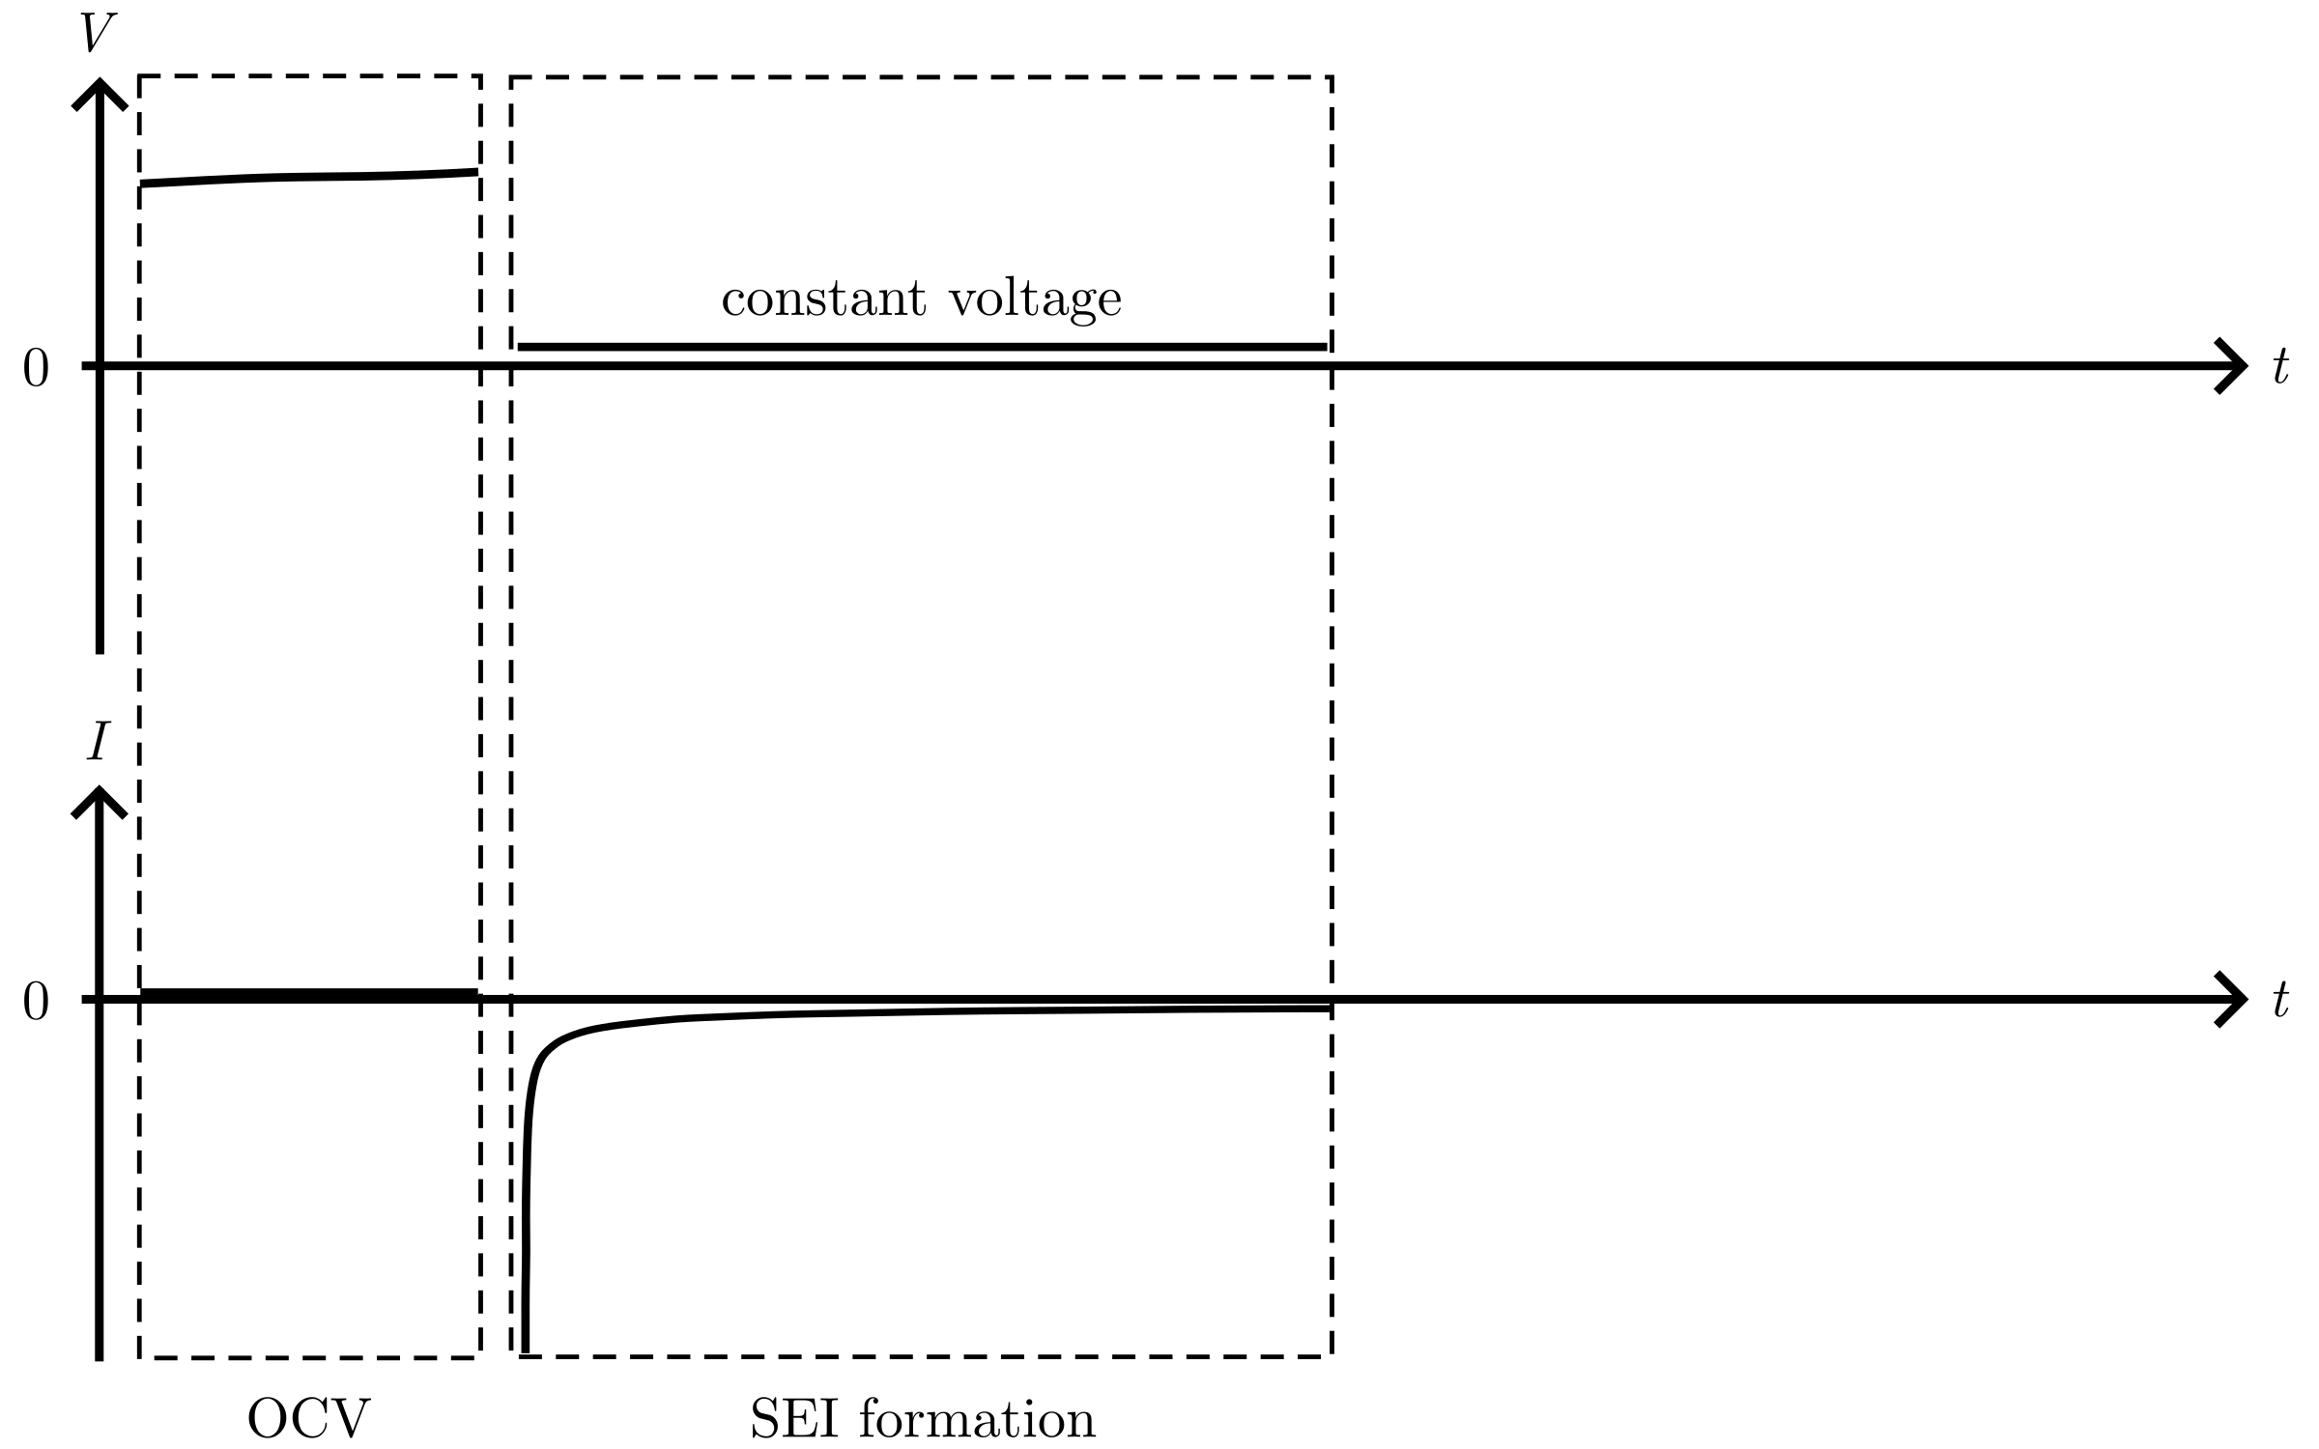
Deposition protocol
Notes:
Next is the important passivation – or SEI formation.
Here, we hold a constant and low voltage.
The electrolyte is broken down and forms the SEI layer on the Cu.
The current, which is allowed to change freely, decreases fast and then slowly.

Slide 62
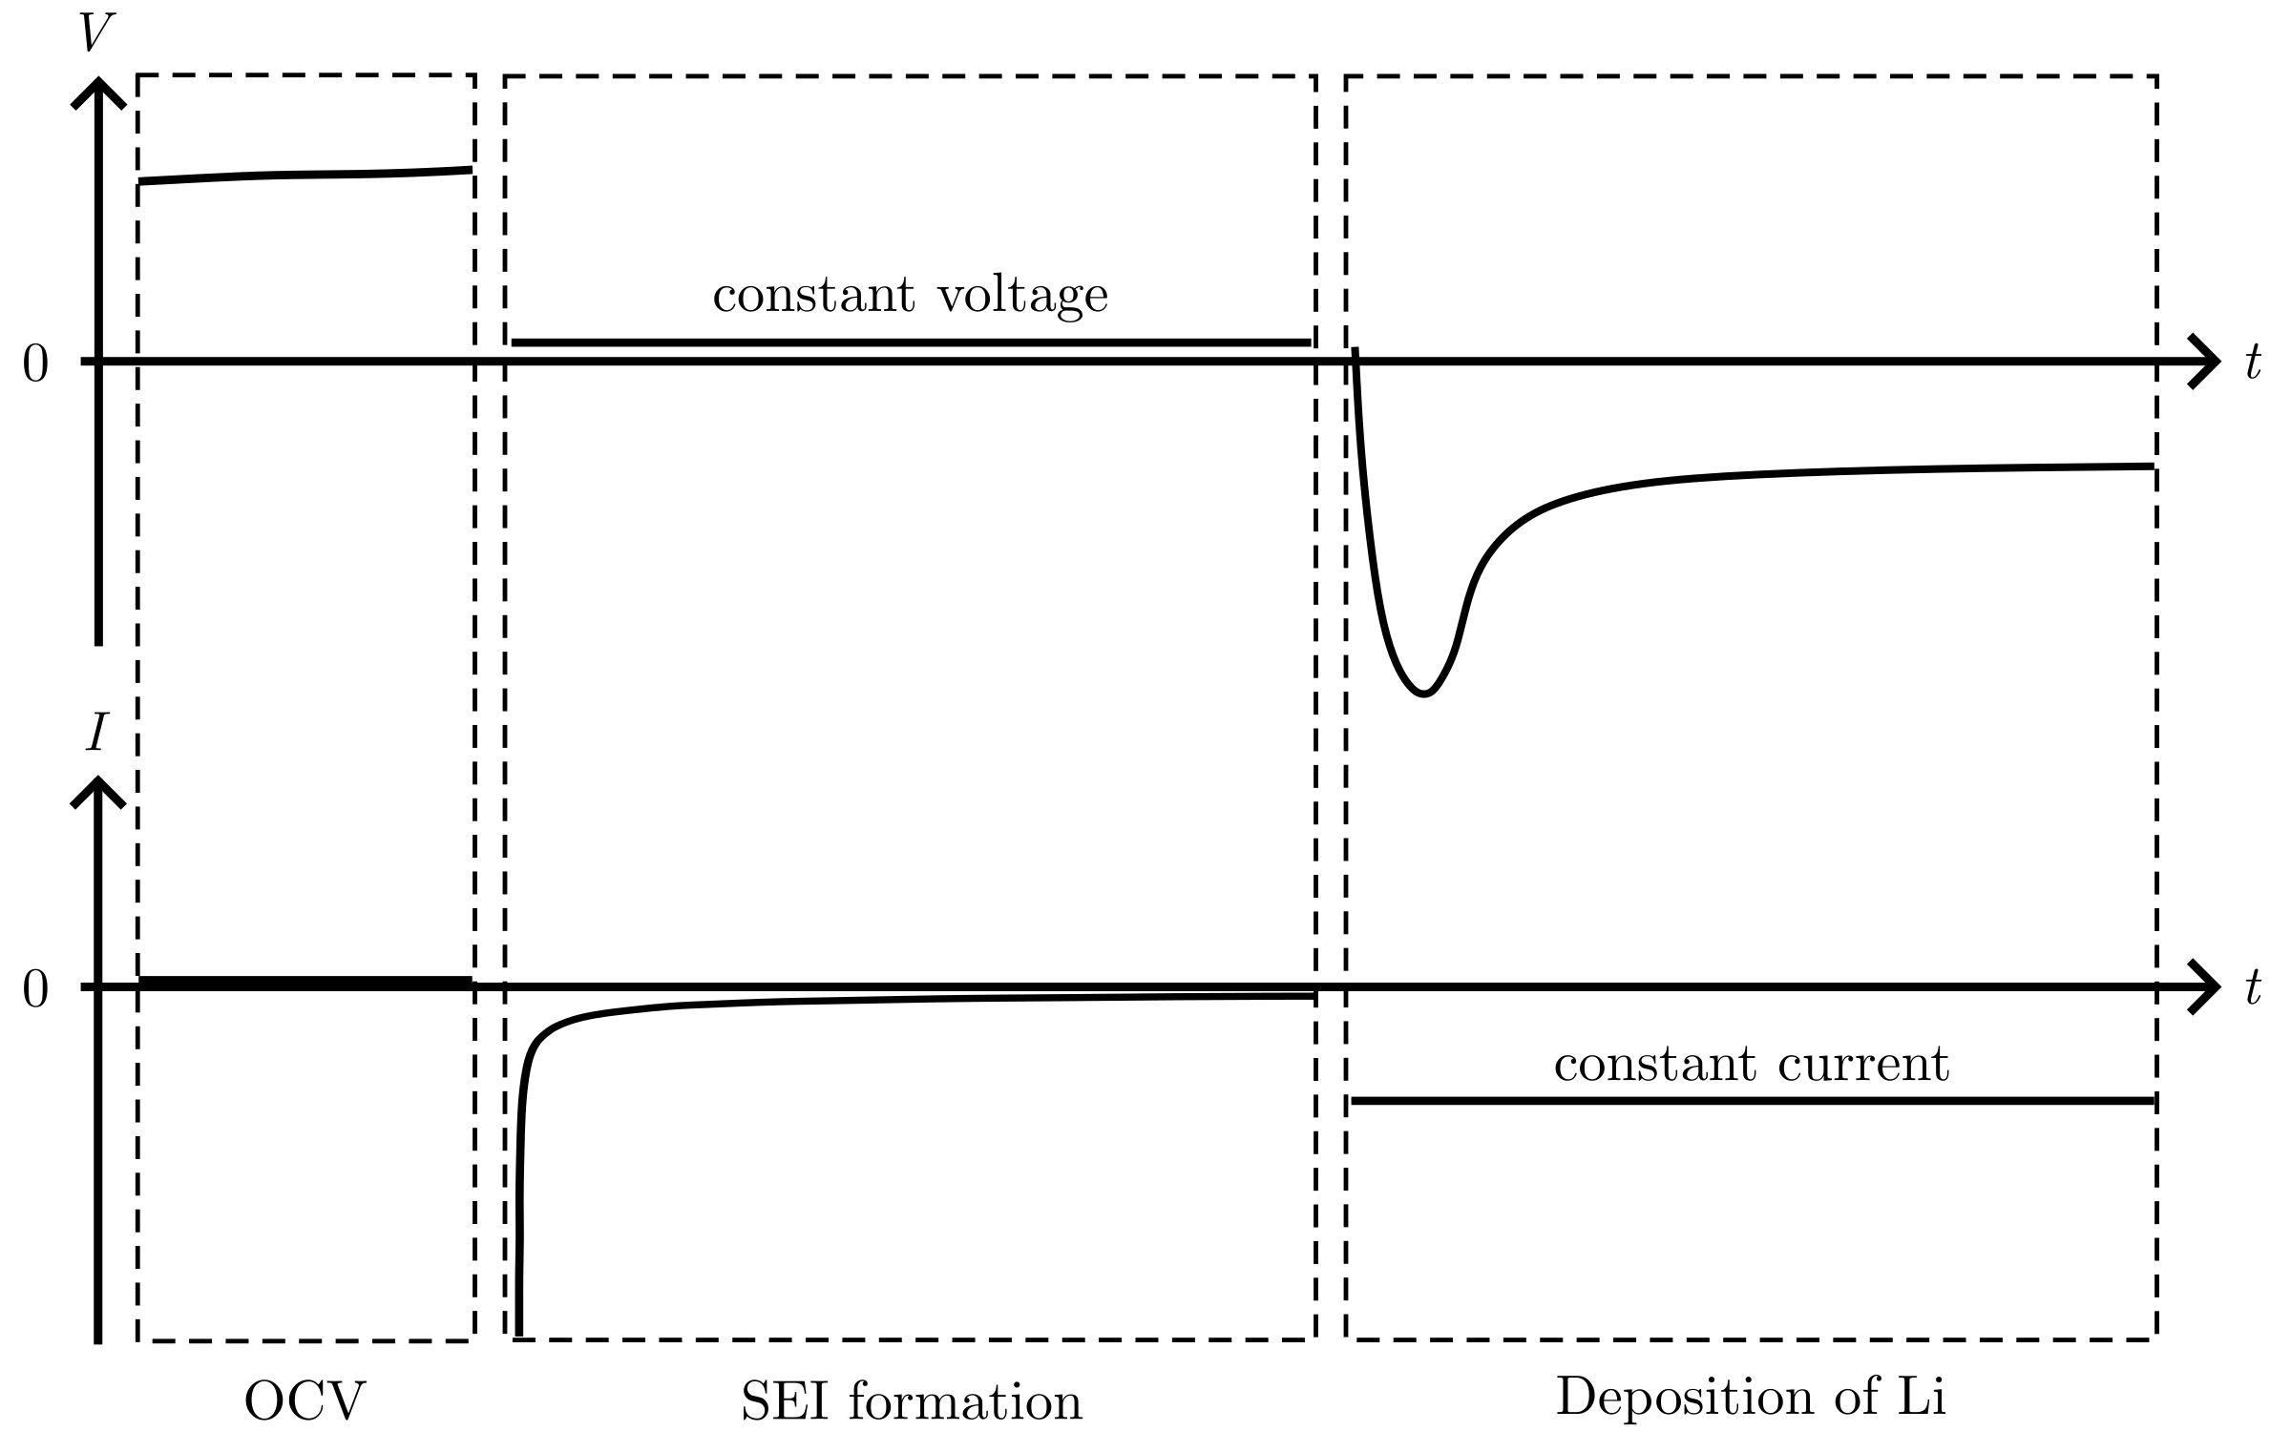
Deposition protocol
Notes:
The next step is the deposition.
A constant current is used, and the voltage is allowed to change freely.
This results in the deposition curve we saw earlier.
The protocol was set up to end the SEI formation …

Slide 63

Deposition protocol
Notes:
once a low cutoff current was reached.
During the low voltage hold, side reactions occur in the cell, including the SEI formation.
As the SEI layer grows in thickness, the side reactions decrease which we can see from the decrease in current.
This is what we mean by “passivating the surface”.

Slide 64
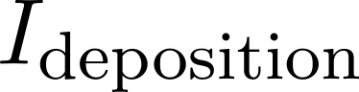
Deposition protocol
Notes:
The deposition occurred at current I_deposition.
Now my specific research questions becomes more clear.
I have investigated how:
1) the deposition curve [point] is influenced by different cutoff currents [point], …

Slide 65
Deposition protocol
Notes:
here…

Slide 66
Deposition protocol
Notes:
Here…

Slide 67
Deposition protocol
Notes:
Or here.
And 2) how the deposition curve [point] varies with different deposition currents [point]
[drink]

Slide 68
Deposition protocol
Notes:
First, we look at different cutoff currents.

Slide 69
Passivation of the Cu surface
Notes:
Several T-cell were cycled.
I’ll show the cell in the bottom left corner so you know.

Slide 70
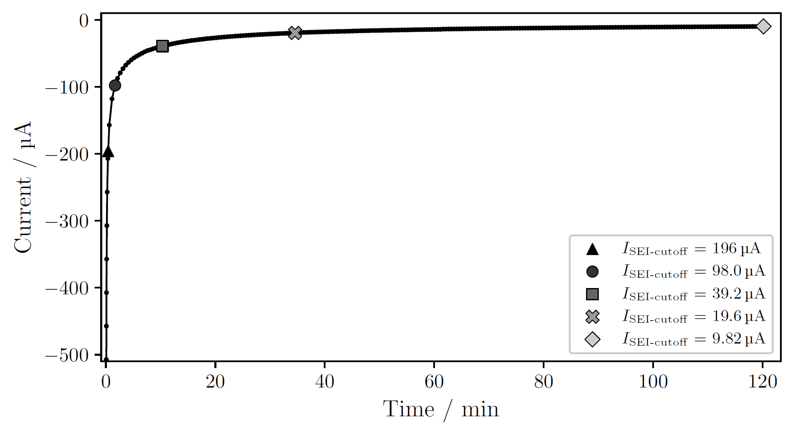
Passivation of the Cu surface
Notes:
Here we see the current versus time during the SEI formation by holding a constant low voltage.
I have stopped the SEI formation for here for one cell, here for another, and here for another.
After the passivation, Li was deposited at constant current

Slide 71
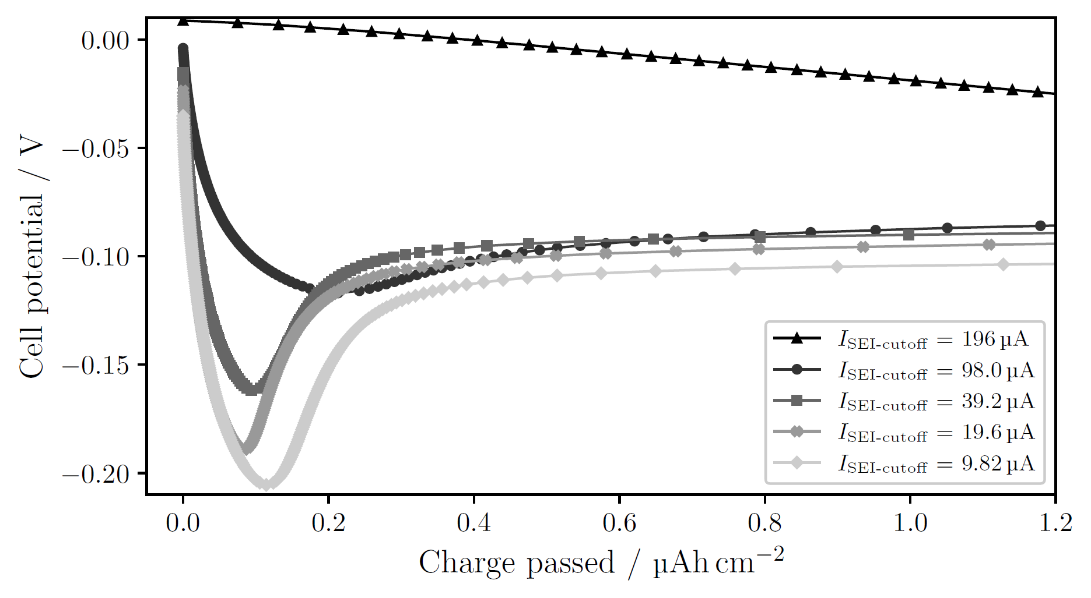
Passivation of the Cu surface
I_{deposition} = 196 µA
Notes:
For large cutoff current: no obvious nucleation; side reactions large enough to drive current without need for nucleation in the beginning
For more passivation, smaller cutoff current → see clearer deposition peak, at larger overpotential
More passivation means less side reactions.
If there are no side reactions then only deposition of Li can provide the current,
→ it is necessary to nucleate a lot in the beginning, which happens if the overpotential is large
Thus, more passivation leads to more instantaneous nucleation, where more or less all nuclei form at the start and then they all grow

Slide 72
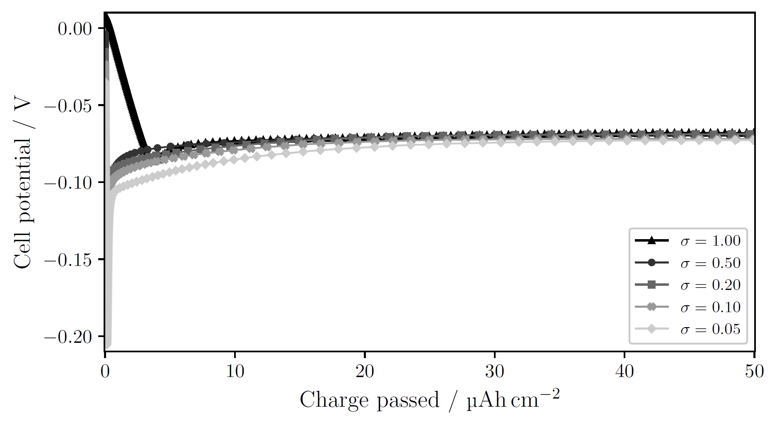
Passivation of the Cu surface larger charge passed
I_{deposition} = 196 µA
Notes:
(hidden) T-cell, 1 mAh/cm²

Slide 73
Deposition protocol
Notes:
Now, let’s look at how different currents during deposition influences the deposition curve.

Slide 74
Deposition current
Notes:
C-cells were cycled with three different currents.

Slide 75
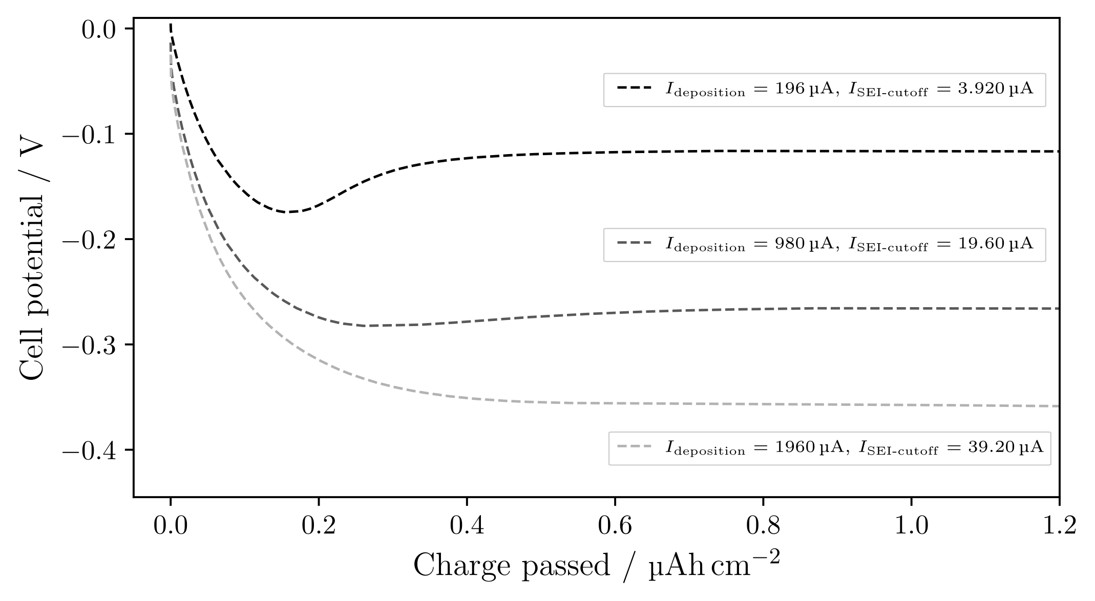
Deposition current
Notes:
One current, a larger one, and an even larger current.
See: larger current → results in a higher overpotential.
And higher overpotential should according to theory…
{J=1, 5, 10 mA/cm2}

Slide 76
Deposition current
Notes:
Result in smaller but more nuclei.
In this case, ratio of the cutoff and deposition current are the same.
And the nucleation peak disappears for larger currents.
We just saw that this [point] peak is dependent on the cutoff current, so what happens if we passivate the surface more?

Slide 77
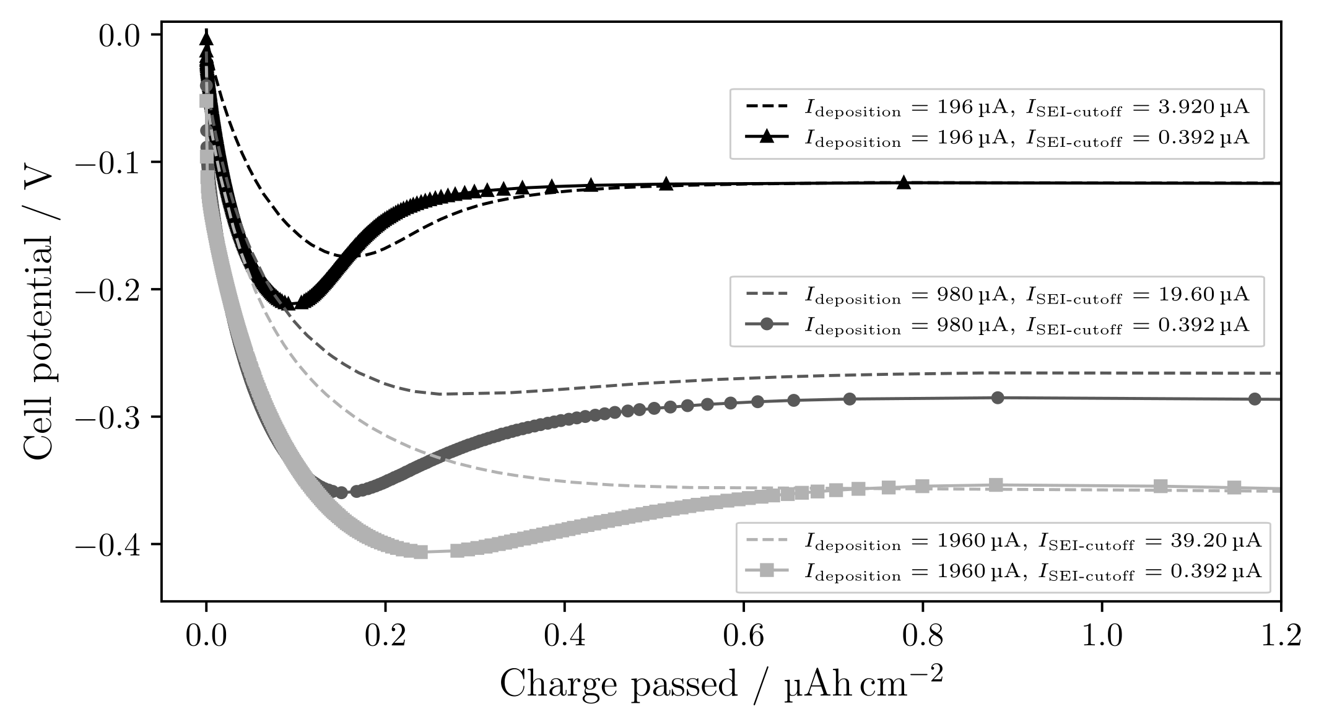
Deposition current with more passivation
Notes:
Here are the same three currents, with more passivation.
Now the deposition peak becomes visible for larger currents.
As discussed, the more pronounced deposition peak, with larger overpotential, indicates more instantaneous nucleation.
Thus, the current used should influence r and N, and the degree of passivation influences the nucleation process.
{J=1, 5, 10 mA/cm2}

Slide 78

Deposition current with more passivation larger charge passed
Notes:
The cells reach more or less the same potential at larger charge passed, indicating either that:
1. The surface gets passivated during the beginning of the deposition.
2. Or, that the growth is not as sensitive to the side reactions as the nucleation is.

Slide 79
Pressure effects
Notes:
To investigate the last point, pressure, a C-cell was first cycled.

Slide 80

Pressure effects
Notes:
Photograph deposited Li on Cu [drink]
We see uneven deposition from the annulus: little to no Li in the middle, but more for larger radii
Photograph: 500 muAh/cm2
SEM-images: 25 muAh/cm2 at 1mA/cm2

Slide 81

Pressure effects
25 µAh/cm²
Notes:
SEM-images were taken for different radii.
Here I’ve matched the features on the images with each other to give a view of a larger area.
Zooming in…

Slide 82

Pressure effects
25 µAh/cm²
Notes:
we see small Li nuclei.

Slide 83

Pressure effects
25 µAh/cm²
Notes:
Moving down, see slightly larger nuclei.

Slide 84

Pressure effects
25 µAh/cm²
Notes:
Here even larger nuclei.
Thus, for various radial positions [point] we see different morphologies of Li: from small crystalline particles to larger ‘’islands’’.

Slide 85
Pressure effects
2r = 1 µm
2r = 2 µm to 3 µm
2r ≥ 4 µm
25 µAh/cm²
Notes:
The typical size (diameter) of the nuclei goes from 1 micro meter here, 2 to 3, and then larger than 4.

Slide 86
Pressure effects
2r = 1 µm
N = 0.024 nuclei/µm²
2r = 2 µm to 3 µm
N = 0.022 nuclei/µm²
2r ≥ 4 µm
N = 0.016 nuclei/µm²
25 µAh/cm²
Notes:
Nuclei per area decreases while the nuclei size increases.

Slide 87
Pressure effects
2r = 1 µm
N = 0.024 nuclei/µm²
2r = 2 µm to 3 µm
N = 0.022 nuclei/µm²
2r ≥ 4 µm
N = 0.016 nuclei/µm²
25 µAh/cm²
Notes:
These relations should be familiar by now. ;)

Slide 88

Pressure effects
Notes:
So, the distribution changes radially. How about the along the edge of the deposition?

Slide 89

Pressure effects
50 µAh/cm²
Notes:
SEM images for different angles around the edge of the deposition.
Photograph: 500 muAh/cm2
SEM-images: 50 muAh/cm2 at 1mA/cm2

Slide 90

Pressure effects
50 µAh/cm²
Notes:
Zoom in: see some particles, and also bush-like growth

Slide 91

Pressure effects
50 µAh/cm²
Notes:
Here it’s mostly round particles

Slide 92

Pressure effects
Notes:
Down here: overwhelmingly bush-like growth.
Yes, the deposition changes also with the angle along the deposited annulus.

Slide 93


Pressure effects
Wave spring
Notes:
The reason is probably due to the wave spring used in the C-cell.
A study found that the wave spring induces uneven pressure in the cell, with low pressure in the middle and higher pressure for larger radii.
Exactly as the annulus of deposited Li shows – with little deposition for low pressure, and more deposition for high pressure.
Photograph shows that the wave spring pushes down at some points [point],
which could explain the angular variation with more deposition, bush-like growth, at those points.

Slide 94
Pressure effects
Notes:
So: uneven pressure → uneven deposition.
Does even pressure make more even deposition?
To find that out, a T-cell was cycled.

Slide 95

Pressure effects
300 µAh/cm²
Notes:
SEM images as before, over the same radial distance as in the C-cell.
The Li distribution and morphology is significantly more even!

Slide 96

Pressure effects
300 µAh/cm²
Notes:
Zoom-in shows that the morphology is small crystalline particles, with longer and thinner needle-like growth.
While ‘’islands’’ were not observed in the T-cell, we can image that this needle-like growth might evolve into the bush-like growth for more deposited Li.
What have we learned? …

Slide 97
Conclusions
1) More instantaneous nucleation can be induced by passivating the surface more before deposition.
Notes:
//read slide

Slide 98
Conclusions
2) For larger deposition currents, a larger overpotential is seen. This should result in smaller nuclei with larger areal density.
Notes:
//read slide

Slide 99
Conclusions
3) Uniform pressure between the electrodes is essential to achieve uniform deposition in Li-metal batteries.
Notes:
//read slide

Slide 100
Thank you for listening!

Slide 101
//Lägg in fler plots här efter på större charge och andra figurer som Isak kanske kommenterar

Slide 102
Electrochemical deposition of lithium on copper
Gottfrid Olsson
2024‒05‒29

